Slide 1

MLA-C01
AWS CERTIFIED
COURSE SLIDES · WSQ
AWS Certified Machine Learning Engineer Associate Training
WSQ Course Code: TGS-2024049340
Conducted by Tertiary Infotech Academy Pte Ltd · UEN 201200696W
Version v14 · 23 August 2026
© 2026 Tertiary Infotech Academy Pte Ltd. All rights reserved. · www.tertiarycourses.com.sg

Slide 2
COURSE ADMINISTRATION
Welcome & Housekeeping
AWS Certified Machine Learning Engineer Associate Training · TGS-2024049340
© 2026 Tertiary Infotech Academy Pte Ltd
1

Slide 3
TRAQOM · SSG DIGITAL ATTENDANCE (AM)
Digital Attendance (Mandatory)
Mandatory each session
Take AM, PM and Assessment digital attendance for WSQ-funded courses.
TRAQOM QR code
The trainer displays the SSG digital-attendance QR code at the start of each session.
1
2
Scan to submit
Scan the QR code with your mobile phone camera and submit your attendance.
75% minimum
At least 75% attendance is required to be eligible for assessment and funding.
3
4
AWS Certified Machine Learning Engineer Associate Training · TGS-2024049340
© 2026 Tertiary Infotech Academy Pte Ltd
2

Slide 4
YOUR TRAINER · GENERAL
About the Trainer
NAME
____________________________________________
?
TITLE / DESIGNATION
____________________________________________
QUALIFICATIONS
____________________________________________
Your Trainer
AREAS OF EXPERTISE
____________________________________________
General Trainer template —
to be completed by the trainer
TRAINING & INDUSTRY EXPERIENCE
____________________________________________
CONTACT
____________________________________________
AWS Certified Machine Learning Engineer Associate Training · TGS-2024049340
© 2026 Tertiary Infotech Academy Pte Ltd
3

Slide 5
YOUR TRAINER
About the Trainer
ROLE
Principal Trainer, Tertiary Infotech Academy Pte Ltd
AA
CERTIFICATION
AWS-certified; cloud, machine learning and data-engineering practitioner and trainer.
Dr Alfred Ang
DELIVERS
WSQ courses on AWS, machine learning, data engineering, AI and cloud architecture.
Principal Trainer
Tertiary Infotech Academy Pte Ltd
FOUNDER
Founder and lead instructor at Tertiary Infotech / Tertiary Courses.
AWS Certified Machine Learning Engineer Associate Training · TGS-2024049340
© 2026 Tertiary Infotech Academy Pte Ltd
4

Slide 6
ICE-BREAKER
Let's Know Each Other
• Your name and organisation / role.
• Your experience with AWS, Python, data or machine learning (if any).
• What you want to be able to build or certify after this course.
AWS Certified Machine Learning Engineer Associate Training · TGS-2024049340
© 2026 Tertiary Infotech Academy Pte Ltd
5

Slide 7
HOUSEKEEPING
Ground Rules
Set your mobile phone to silent mode.
Participate actively — no question is too small.
1
2
Mutual respect: agree to disagree.
One conversation at a time.
3
4
Be punctual; return from breaks on time.
75% attendance is required.
5
6
AWS Certified Machine Learning Engineer Associate Training · TGS-2024049340
© 2026 Tertiary Infotech Academy Pte Ltd
6

Slide 8
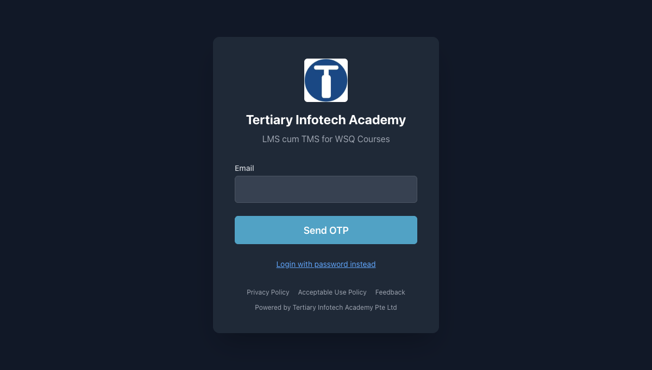
COURSE PORTAL · LMS-TMS
Download Course Material
1
Open lms-tms.tertiaryinfotech.com in your browser.
lms-tms.tertiaryinfotech.com
2
Log in with the account emailed to you before the course.
3
Open this course and go to the Courseware / Materials tab.
4
Download the Trainer Slides, Learner Guide and Lesson Plan.
5
Keep them open — the assessment is open book.
AWS Certified Machine Learning Engineer Associate Training · TGS-2024049340
© 2026 Tertiary Infotech Academy Pte Ltd
7

Slide 9
SCHEDULE
Lesson Plan — 3 Days · 24 Course Hours
Day 1 — Data Preparation for Machine Learning
Domain 1 · Labs 1–4: account safety & IAM, S3 data lake, batch/streaming ingestion, feature engineering.
Day 2 — ML Model Development
Domain 2 · Labs 5–8: modelling approach, training & Debugger, tuning & registry, evaluation & bias.
1
2
Day 3 — Deployment, Monitoring, Security & Exam Review
Domains 3–4 · Labs 9–12: deployment, MLOps, monitoring, security, cost & exam review.
Assessment (Day 3)
Written Assessment (1 hour) + Case Study (1 hour) = 2 assessment hours.
3
4
Duration
22 learning hours + 2 assessment hours = 24 course hours across 3 days.
Daily timing
9:30am–6:30pm · 1-hour lunch · two 15-min tea breaks within the 8 scheduled hours.
5
6
AWS Certified Machine Learning Engineer Associate Training · TGS-2024049340
© 2026 Tertiary Infotech Academy Pte Ltd
8

Slide 10
WHAT YOU'LL ACHIEVE
Learning Outcomes
LO1 · Data Preparation
Ingest, transform, engineer features for, and govern ML data on AWS.
LO2 · Model Development
Select, train, tune, evaluate and register models with SageMaker AI.
1
2
LO3 · Deploy & Orchestrate
Real-time, serverless and batch inference; MLOps pipelines and CI/CD.
LO4 · Monitor & Secure
Monitoring, security, cost optimisation and MLA-C01 exam readiness.
3
4
AWS Certified Machine Learning Engineer Associate Training · TGS-2024049340
© 2026 Tertiary Infotech Academy Pte Ltd
9

Slide 11
WSQ FUNDING
Criteria for Funding
Attendance
Attend at least 75% of the course.
Competency
Be assessed Competent (C) in both the WA and the Case Study (CS).
1
2
Digital attendance
Take AM, PM and Assessment digital attendance (TRAQOM) each day.
Survey
Complete the TRAQOM course survey.
3
4
Eligibility
Meet SSG/SkillsFuture eligibility for the applicable funding scheme.
5
AWS Certified Machine Learning Engineer Associate Training · TGS-2024049340
© 2026 Tertiary Infotech Academy Pte Ltd
10

Slide 12
BEFORE THE ASSESSMENT
Briefing for Assessment
Place phones and other materials under the table or on the floor.
No photos or recording of assessment scripts.
1
2
No discussion during the assessment.
Use a black/blue pen for hard-copy assessments.
3
4
No liquid paper / correction tape.
Scripts are collected when time is up.
5
6
AWS Certified Machine Learning Engineer Associate Training · TGS-2024049340
© 2026 Tertiary Infotech Academy Pte Ltd
11

Slide 13
FINAL ASSESSMENT
Assessment
• Written Assessment (WA) — Short-Answer Questions (SAQ), 1 hour, open book. Knowledge questions trace to specific course slides.
• Case Study (CS) — an applied AWS ML scenario, 1 hour, open book. Learners analyse a business scenario and design and justify an end-to-end ML solution mapped to the four MLA-C01 domains and the twelve hands-on labs.
• Format: Open Book — slides, Learner Guide and approved materials only.
• Held on Day 3: Written Assessment (1 hour) then Case Study (1 hour) = 2 assessment hours.
• A minimum of 75% attendance is required to be eligible for assessment and funding.
• An appeal process is available if required.
AWS Certified Machine Learning Engineer Associate Training · TGS-2024049340
© 2026 Tertiary Infotech Academy Pte Ltd
12

Slide 14
ON ASSESSMENT DAY
Assessment Flow
1
2
3
4
5
▶
▶
▶
▶
TRAQOM survey — scan the QR code on the LMS
Assessment digital attendance — scan the SSG QR
Sit WA (SAQ) then Case Study (CS) — open book
Submit your answers on the LMS
Sign the Assessment Summary Record
AWS Certified Machine Learning Engineer Associate Training · TGS-2024049340
© 2026 Tertiary Infotech Academy Pte Ltd
13

Slide 15
CORE CONCEPTS
AWS Machine Learning Engineering
AWS Certified Machine Learning Engineer Associate Training · TGS-2024049340
© 2026 Tertiary Infotech Academy Pte Ltd
14

Slide 16
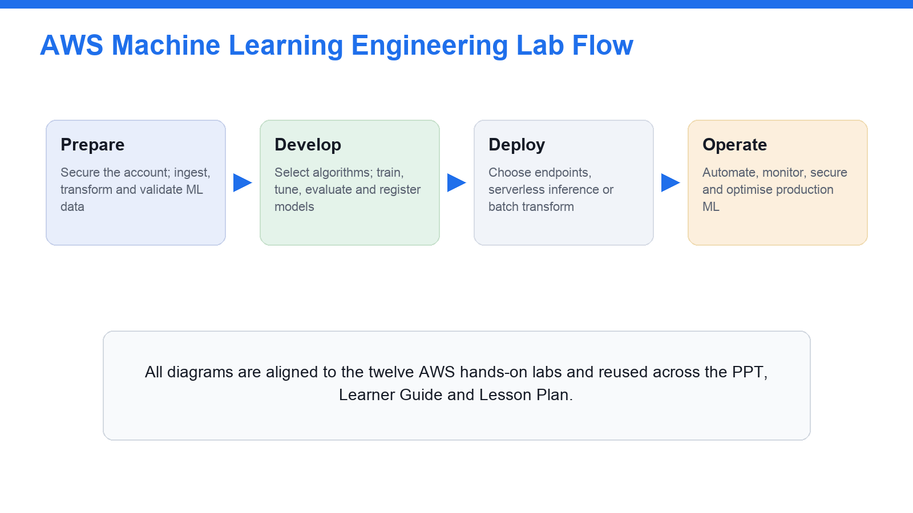
THE COURSE AT A GLANCE
AWS Machine Learning Engineering Lab Flow
Prepare → Develop → Deploy → Operate — the twelve labs follow the ML lifecycle.
AWS Certified Machine Learning Engineer Associate Training · TGS-2024049340
© 2026 Tertiary Infotech Academy Pte Ltd
15

Slide 17
END TO END
The Machine Learning Lifecycle on AWS
1 · Prepare data
Ingest, store, transform and validate data; engineer and store features (Domain 1).
2 · Develop model
Choose an approach; train, tune, evaluate, and register the model (Domain 2).
1
2
3 · Deploy & orchestrate
Serve inference and automate the pipeline with MLOps (Domain 3).
4 · Monitor & secure
Monitor drift, secure, and cost-optimise in production (Domain 4).
3
4
Repeatable
SageMaker Pipelines, Model Registry and IaC make each stage repeatable.
Exam-aligned
Every stage maps to an MLA-C01 domain and a hands-on lab.
5
6
AWS Certified Machine Learning Engineer Associate Training · TGS-2024049340
© 2026 Tertiary Infotech Academy Pte Ltd
16

Slide 18
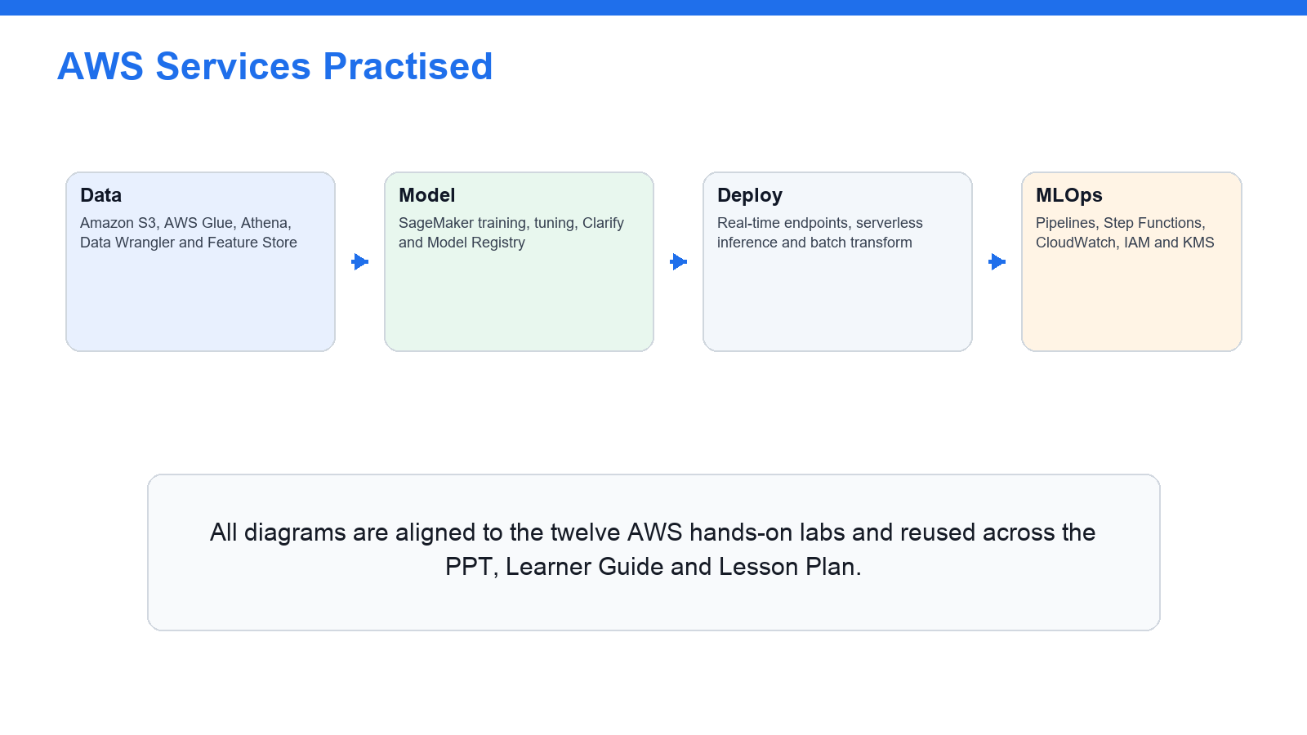
THE SERVICE STACK
AWS Services You Will Practise
Data, Model, Deploy and MLOps services used across the twelve labs.
AWS Certified Machine Learning Engineer Associate Training · TGS-2024049340
© 2026 Tertiary Infotech Academy Pte Ltd
17

Slide 19
DATA FUNDAMENTALS
Data Types & Formats for ML
Structured
Tabular rows/columns — CSV, Parquet, ORC for analytics and SageMaker training.
Semi-structured
JSON, Avro — flexible schemas, common for ingestion and streaming.
1
2
Unstructured
Text, image, audio, video — for NLP, computer vision and generative AI.
Format choice
Columnar (Parquet/ORC) for analytics; RecordIO/protobuf for efficient training.
3
4
Storage
Amazon S3 data lake with lifecycle prefixes and default encryption.
Governance
Glue Data Catalog, Lake Formation and Clarify for quality and bias.
5
6
AWS Certified Machine Learning Engineer Associate Training · TGS-2024049340
© 2026 Tertiary Infotech Academy Pte Ltd
18

Slide 20
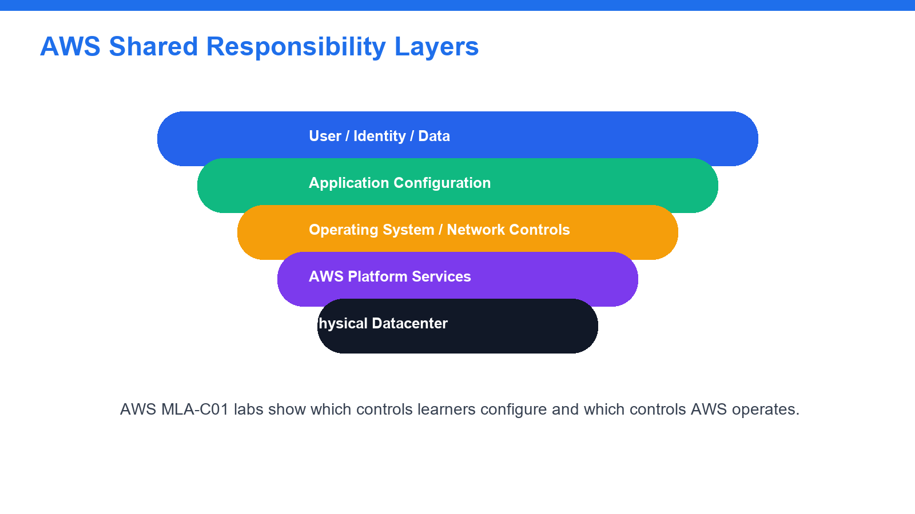
SECURITY MODEL
Shared Responsibility for ML on AWS
AWS secures the cloud; you secure your ML data, models and access in the cloud.
AWS Certified Machine Learning Engineer Associate Training · TGS-2024049340
© 2026 Tertiary Infotech Academy Pte Ltd
19

Slide 21
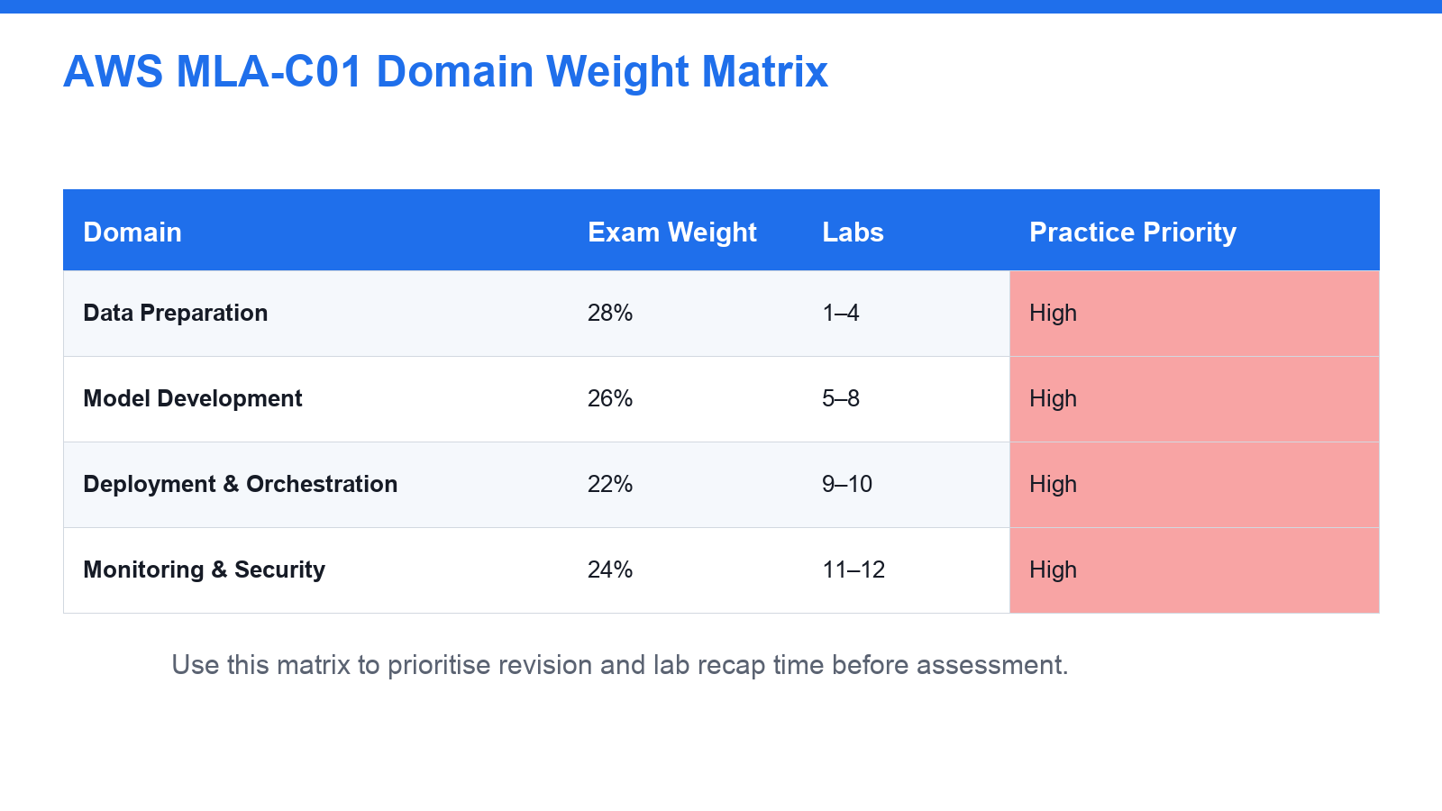
WHAT THE EXAM COVERS
MLA-C01 Exam Domains & Weightings
Four domains — the course spends time in proportion to their exam weighting.
AWS Certified Machine Learning Engineer Associate Training · TGS-2024049340
© 2026 Tertiary Infotech Academy Pte Ltd
20

Slide 22
01
DOMAIN 01
Data Preparation for Machine Learning
Ingestion & storage · transformation & feature engineering · data quality, labelling & bias
AWS Certified Machine Learning Engineer Associate Training · TGS-2024049340
© 2026 Tertiary Infotech Academy Pte Ltd
21

Slide 23
MLA-C01 EXAM WEIGHTING 28%
Key Concepts — Data Preparation for Machine Learning
Data formats
CSV, JSON, Parquet, ORC, Avro and RecordIO — column vs row storage, and which format suits analytics, streaming and SageMaker training.
S3 ML data lake
Bucket + prefix design (raw/prepared/features/training/models/monitoring), default encryption (SSE-S3 / SSE-KMS) and Block Public Access.
1
2
Batch & streaming ingestion
AWS Glue crawlers/jobs and the Data Catalog, Athena, and the Kinesis family (Data Streams, Firehose, MSK) for batch and streaming preparation.
Feature engineering
Imputation, normalisation/standardisation, binning, one-hot encoding and scaling; online vs offline SageMaker Feature Store.
3
4
Labelling
SageMaker Ground Truth labelling jobs for text, image and tabular data; human-in-the-loop and automated labelling.
Data quality & bias
Glue Data Quality and SageMaker Clarify checks for nulls, duplicates, schema drift, outliers, class imbalance and data leakage.
5
6
AWS Certified Machine Learning Engineer Associate Training · TGS-2024049340
© 2026 Tertiary Infotech Academy Pte Ltd
22

Slide 24
DOMAIN 01 · DATA FORMATS
ML Data Formats Compared
Format
Layout
Best used for
CSV
Row, text
Human-readable ingestion and small tabular datasets
JSON
Semi-structured
APIs, nested records and event/log data
Parquet
Columnar, compressed
Analytics and large-scale SageMaker training
ORC
Columnar, compressed
Hive/analytics workloads with predicate push-down
Avro
Row + embedded schema
Streaming and schema evolution
RecordIO-protobuf
Binary
Efficient input to several SageMaker built-in algorithms
AWS Certified Machine Learning Engineer Associate Training · TGS-2024049340
© 2026 Tertiary Infotech Academy Pte Ltd
23

Slide 25
DOMAIN 01 · KNOW YOUR DATA
Data Types for Machine Learning
Structured
Tabular rows/columns — CSV, Parquet, ORC for analytics and training.
Semi-structured
JSON and Avro — flexible, nested schemas common in ingestion.
1
2
Unstructured
Text, image, audio, video for NLP, vision and generative AI.
Labelled vs unlabelled
Supervised needs labels (Ground Truth); unsupervised does not.
3
4
Time-series
Ordered observations for forecasting and anomaly detection.
Streaming vs at-rest
Live events vs data already landed in the S3 data lake.
5
6
AWS Certified Machine Learning Engineer Associate Training · TGS-2024049340
© 2026 Tertiary Infotech Academy Pte Ltd
24

Slide 26
DOMAIN 01 · PROTECT DATA AT REST
Amazon S3 Encryption Options
Option
Key management
Choose when
SSE-S3
S3-managed AES-256
A simple, always-on default for training data
SSE-KMS
AWS KMS (CMK)
You need audit logs, rotation and access control on the key
SSE-C
Customer-supplied
You must hold and provide the key on each request
Client-side
Encrypted before upload
Data must be encrypted before it reaches AWS
TLS in transit
HTTPS/SSL
Always — protects data moving to and from S3
AWS Certified Machine Learning Engineer Associate Training · TGS-2024049340
© 2026 Tertiary Infotech Academy Pte Ltd
25

Slide 27
DOMAIN 01 · COST-AWARE STORAGE
S3 Storage Classes & Lifecycle for ML
S3 Standard
Hot raw and training data accessed frequently.
Intelligent-Tiering
Unknown/changing access — S3 moves objects automatically.
1
2
Standard-IA / One Zone-IA
Prepared datasets kept but read infrequently.
Glacier Instant / Flexible
Archived training snapshots and old model artifacts.
3
4
Lifecycle rules
Transition raw→IA→Glacier and expire temp objects on a schedule.
Block Public Access
Keep enabled on every ML bucket to prevent data exposure.
5
6
AWS Certified Machine Learning Engineer Associate Training · TGS-2024049340
© 2026 Tertiary Infotech Academy Pte Ltd
26

Slide 28
DOMAIN 01 · SECURE THE WORKSPACE
IAM & Access Control for ML
Users, groups, roles
Prefer roles over long-lived keys; group common permissions.
Least privilege
Grant only the S3/SageMaker/Glue actions each task needs.
1
2
SageMaker execution role
The role SageMaker assumes to read S3 and write artifacts.
MFA
Protect human sign-in with multi-factor authentication.
3
4
Policies & conditions
Identity, resource and permission-boundary policies with conditions.
KMS key policies / grants
Control who can use the CMK that encrypts ML data.
5
6
AWS Certified Machine Learning Engineer Associate Training · TGS-2024049340
© 2026 Tertiary Infotech Academy Pte Ltd
27

Slide 29
DOMAIN 01 · HOW DATA ARRIVES
Batch vs Streaming Ingestion
Aspect
Batch
Streaming
Services
Glue jobs, EMR (Spark), Athena, DMS
Kinesis Data Streams, Data Firehose, Managed Kafka
Latency
Minutes to hours
Seconds — near real time
Typical use
Nightly ETL, historical reprocessing
Clickstream, IoT, live features
Lands in
S3 data lake, cataloged by Glue
S3/Firehose → Glue crawler → Catalog
AWS Certified Machine Learning Engineer Associate Training · TGS-2024049340
© 2026 Tertiary Infotech Academy Pte Ltd
28

Slide 30
DOMAIN 01 · CATALOG & TRANSFORM
AWS Glue Components
Crawlers
Scan S3, infer schema and populate the Data Catalog.
Data Catalog
Central table/partition metadata shared by Athena, EMR, SageMaker.
1
2
Glue ETL jobs
Serverless Spark jobs that clean and reshape data to Parquet.
Glue DataBrew
Visual, no-code profiling and cleaning of datasets.
3
4
Glue Data Quality
Rule-based checks for nulls, ranges, uniqueness and freshness.
Triggers & workflows
Schedule or event-chain crawlers and jobs into a pipeline.
5
6
AWS Certified Machine Learning Engineer Associate Training · TGS-2024049340
© 2026 Tertiary Infotech Academy Pte Ltd
29

Slide 31
DOMAIN 01 · REAL-TIME DATA
Streaming Ingestion Family
Service
Does
Best for
Kinesis Data Streams
Durable, shard-based real-time stream
Custom consumers, sub-second processing
Kinesis Data Firehose
Managed delivery to S3/Redshift/OpenSearch
No-code load of streams into the lake
Managed Service for Kafka
Managed Apache Kafka (MSK)
Kafka-based ecosystems and high throughput
Managed Flink
Real-time analytics on streams
In-stream aggregation and feature computation
AWS Certified Machine Learning Engineer Associate Training · TGS-2024049340
© 2026 Tertiary Infotech Academy Pte Ltd
30

Slide 32
DOMAIN 01 · SHAPE THE FEATURES
Feature Engineering Transforms
Missing-value imputation
Fill nulls with mean/median/mode or a model.
Scaling / normalisation
Standardise or min-max scale numeric features.
1
2
Encoding categoricals
One-hot, label or target encoding for categories.
Binning & bucketing
Group continuous values into ranges.
3
4
Outlier handling
Cap, clip or remove extreme values.
Avoid data leakage
Never use future/target-derived information as a feature.
5
6
AWS Certified Machine Learning Engineer Associate Training · TGS-2024049340
© 2026 Tertiary Infotech Academy Pte Ltd
31

Slide 33
DOMAIN 01 · REUSABLE FEATURES
SageMaker Feature Store — Online vs Offline
Store
Latency
Used for
Online store
Single-digit ms
Real-time inference feature lookups
Offline store
Batch (S3)
Training datasets and historical analysis
Feature groups
—
Versioned schema of related features
Consistency
—
Same feature definition for train and serve
AWS Certified Machine Learning Engineer Associate Training · TGS-2024049340
© 2026 Tertiary Infotech Academy Pte Ltd
32

Slide 34
DOMAIN 01 · TRUSTWORTHY DATA
Labelling, Data Quality & Bias
Ground Truth
Managed labelling for text, image and tabular data.
Human-in-the-loop
A2I adds human review to low-confidence predictions.
1
2
Automated labelling
Active learning labels the easy cases to cut cost.
Glue Data Quality
Automated rule checks on nulls, ranges and freshness.
3
4
Clarify pre-training bias
Detect class imbalance and skew before training.
Data-leakage checks
Remove target/future signals that inflate scores.
5
6
AWS Certified Machine Learning Engineer Associate Training · TGS-2024049340
© 2026 Tertiary Infotech Academy Pte Ltd
33

Slide 35
DOMAIN 01 · PICK THE RIGHT TOOL
Choosing a Data-Preparation Service
Visual, no-code cleaning and profiling
▶
AWS Glue DataBrew
Interactive feature engineering for ML
▶
SageMaker Data Wrangler
Large-scale distributed ETL (Spark)
▶
AWS Glue jobs or Amazon EMR
Ad-hoc SQL exploration of data in S3
▶
Amazon Athena
Near-real-time event ingestion into S3
▶
Kinesis Data Firehose
Reusable features shared train/serve
▶
SageMaker Feature Store
Data labelling for text/image/tabular
▶
SageMaker Ground Truth
AWS Certified Machine Learning Engineer Associate Training · TGS-2024049340
© 2026 Tertiary Infotech Academy Pte Ltd
34

Slide 36
DOMAIN 01 · QUERY IN PLACE
Amazon Athena & the Glue Data Catalog
Serverless SQL
Query S3 data directly with standard SQL — no servers.
Glue Data Catalog
Shared table/partition metadata for Athena and SageMaker.
1
2
Partitioning
Partition by date/key to cut scan cost and time.
Columnar wins
Parquet/ORC scan far less data than CSV.
3
4
CTAS / views
Create prepared tables and reusable views for ML.
Cost model
You pay per terabyte scanned — prune columns and partitions.
5
6
AWS Certified Machine Learning Engineer Associate Training · TGS-2024049340
© 2026 Tertiary Infotech Academy Pte Ltd
35

Slide 37
DOMAIN 01 · VISUAL FEATURE PREP
SageMaker Data Wrangler Transforms
Import
Connect to S3, Athena, Redshift and more.
Data insights
Automatic profiling and quality warnings.
1
2
300+ transforms
Built-in cleaning, encoding and scaling steps.
Custom transforms
Add pandas/PySpark/SQL steps where needed.
3
4
Export
Push the flow to a processing job or pipeline.
Feature Store target
Write engineered features straight to Feature Store.
5
6
AWS Certified Machine Learning Engineer Associate Training · TGS-2024049340
© 2026 Tertiary Infotech Academy Pte Ltd
36

Slide 38
WHAT YOU'LL DO
Hands-On Labs — Data Preparation for Machine Learning
Labs 1–2
Labs 3–4
—
• Account Safety and IAM Baseline
• S3 ML Data Lake and Data Formats
• Batch and Streaming Ingestion with Glue, Athena and Kinesis
• Feature Engineering, Feature Store, Labelling and Data Quality
• —
AWS Certified Machine Learning Engineer Associate Training · TGS-2024049340
© 2026 Tertiary Infotech Academy Pte Ltd
37

Slide 39
DOMAIN 01 · HANDS-ON BRIEFING
Account Safety and IAM Baseline
LAB 1
Set up a safe AWS baseline for ML engineering: confirm identity and Region, review IAM users, roles, groups and least privilege, understand the SageMaker execution role, enable MFA and a budget alert, and review KMS key concepts before any data lands.
You'll build
A secured AWS ML workspace: verified identity/Region, a least-privilege IAM review, an enabled budget alert and notes on execution roles and KMS.
Tools: IAM, AWS KMS, AWS Budgets, Amazon SageMaker AI, AWS CloudShell, AWS CloudTrail
AWS Certified Machine Learning Engineer Associate Training · TGS-2024049340
© 2026 Tertiary Infotech Academy Pte Ltd
38

Slide 40
LAB 1 · ARCHITECTURE & WORKFLOW
Workflow — Account Safety and IAM Baseline
1
2
3
4
5
▶
▶
▶
▶
Sign in & verify identity/Region
Review IAM roles & least privilege
Review the SageMaker execution role
Enable MFA & a budget alert
Review KMS key concepts
AWS Certified Machine Learning Engineer Associate Training · TGS-2024049340
© 2026 Tertiary Infotech Academy Pte Ltd
39

Slide 41
LAB 1 · KEY DECISIONS
Trade-offs — Account Safety and IAM Baseline
Use IAM roles when
Use IAM users/keys when
• Granting AWS services access (execution roles)
• Temporary, auto-rotated credentials
• Cross-account or federated access
• A human needs console sign-in
• No role-assumption path is available
• Always protect with MFA and rotation
AWS Certified Machine Learning Engineer Associate Training · TGS-2024049340
© 2026 Tertiary Infotech Academy Pte Ltd
40

Slide 42
LAB 1 · VERIFY & TROUBLESHOOT
Account Safety and IAM Baseline
✅ Test it — acceptance criteria
You can verify your identity and Region, explain least-privilege IAM and the SageMaker execution role, and confirm MFA, a budget alert and KMS are in place before any ML data lands.
Troubleshooting
Access denied calling an ML API
Attach a least-privilege policy for that action to your role/user.
SageMaker cannot read S3
Fix the SageMaker execution role's S3 permissions and trust policy.
Surprise charges appear
Enable AWS Budgets alerts and delete idle resources immediately.
AWS Certified Machine Learning Engineer Associate Training · TGS-2024049340
© 2026 Tertiary Infotech Academy Pte Ltd
41

Slide 43
DOMAIN 01 · HANDS-ON BRIEFING
S3 ML Data Lake and Data Formats
LAB 2
Build the storage foundation for ML: create an encrypted S3 data lake with raw, prepared, features, training, models and monitoring prefixes, apply Block Public Access, lifecycle rules and storage classes, and compare the data formats used across ML workflows.
You'll build
A secure, encrypted S3 ML data lake with six lifecycle prefixes and a data-format comparison table.
Tools: Amazon S3, AWS KMS, S3 Lifecycle, Amazon SageMaker AI
AWS Certified Machine Learning Engineer Associate Training · TGS-2024049340
© 2026 Tertiary Infotech Academy Pte Ltd
42

Slide 44
LAB 2 · ARCHITECTURE & WORKFLOW
Workflow — S3 ML Data Lake and Data Formats
1
2
3
4
5
▶
▶
▶
▶
Create an encrypted S3 bucket
Enable Block Public Access
Add ML lifecycle prefixes
Set storage-class lifecycle rules
Compare data formats
AWS Certified Machine Learning Engineer Associate Training · TGS-2024049340
© 2026 Tertiary Infotech Academy Pte Ltd
43

Slide 45
LAB 2 · KEY DECISIONS
Trade-offs — S3 ML Data Lake and Data Formats
Use SSE-KMS when
SSE-S3 is enough when
• You need key rotation and audit logs
• Fine-grained key access control
• Regulated data (PII/PHI)
• A simple always-on default is fine
• No per-key access control needed
• Lowest operational overhead
AWS Certified Machine Learning Engineer Associate Training · TGS-2024049340
© 2026 Tertiary Infotech Academy Pte Ltd
44

Slide 46
LAB 2 · VERIFY & TROUBLESHOOT
S3 ML Data Lake and Data Formats
✅ Test it — acceptance criteria
You can navigate the encrypted S3 data lake with its six prefixes, explain storage-class lifecycle, and justify a data-format choice for analytics, streaming and SageMaker training.
Troubleshooting
Bucket name already exists
S3 names are globally unique — add your initials/date.
Access denied on PutObject
Attach a least-privilege S3 policy to your role/execution role.
Objects not encrypted
Set default bucket encryption; existing objects must be re-copied.
AWS Certified Machine Learning Engineer Associate Training · TGS-2024049340
© 2026 Tertiary Infotech Academy Pte Ltd
45

Slide 47
DOMAIN 01 · HANDS-ON BRIEFING
Batch and Streaming Ingestion with Glue, Athena and…
LAB 3
Land data into the lake two ways: crawl and catalog batch data with AWS Glue and query it with Athena, and design a near-real-time streaming path with the Kinesis family (Data Streams, Firehose, MSK) into S3, then compare batch and streaming trade-offs.
You'll build
A cataloged batch dataset queryable in Athena plus a streaming-ingestion design and a batch-vs-streaming comparison.
Tools: AWS Glue, Glue Data Catalog, Amazon Athena, Kinesis Data Streams, Kinesis Data Firehose, Amazon MSK, Amazon S3
AWS Certified Machine Learning Engineer Associate Training · TGS-2024049340
© 2026 Tertiary Infotech Academy Pte Ltd
46

Slide 48
LAB 3 · ARCHITECTURE & WORKFLOW
Workflow — Batch and Streaming Ingestion with…
1
2
3
4
5
▶
▶
▶
▶
Crawl raw/ with Glue
Catalog the schema
Query in Athena
Design a Kinesis streaming path
Compare batch vs streaming
AWS Certified Machine Learning Engineer Associate Training · TGS-2024049340
© 2026 Tertiary Infotech Academy Pte Ltd
47

Slide 49
LAB 3 · KEY DECISIONS
Trade-offs — Batch and Streaming Ingestion with…
Batch ingestion (Glue/EMR)
Streaming ingestion (Kinesis)
• Scheduled, large-scale Spark ETL
• Writes columnar Parquet to S3
• Best for full historical loads
• Near-real-time event capture
• Firehose delivers to S3 with no code
• Best for clickstream/IoT/live features
AWS Certified Machine Learning Engineer Associate Training · TGS-2024049340
© 2026 Tertiary Infotech Academy Pte Ltd
48

Slide 50
LAB 3 · VERIFY & TROUBLESHOOT
Batch and Streaming Ingestion with Glue, Athena and…
✅ Test it — acceptance criteria
You can catalog and query batch data with Glue and Athena, design a Kinesis streaming path into the lake, and justify batch vs streaming from latency and use-case requirements.
Troubleshooting
Crawler finds no tables
Point the crawler at the correct S3 prefix and re-run it.
Athena query fails
Set an S3 query-result location and confirm the Glue table exists.
Streaming data not landing in S3
Check the Firehose delivery stream's IAM role and S3 destination.
AWS Certified Machine Learning Engineer Associate Training · TGS-2024049340
© 2026 Tertiary Infotech Academy Pte Ltd
49

Slide 51
DOMAIN 01 · HANDS-ON BRIEFING
Feature Engineering, Feature Store, Labelling and…
LAB 4
Turn cataloged data into trustworthy features: apply feature-engineering transforms in Data Wrangler, store reusable features in SageMaker Feature Store, review Ground Truth labelling, and validate quality and bias with Glue Data Quality and SageMaker Clarify.
You'll build
A feature-engineering flow, an online/offline Feature Store design, and feature-engineering, data-quality and bias checklists.
Tools: SageMaker Data Wrangler, Feature Store, Ground Truth, Clarify, AWS Glue, Glue Data Quality, Amazon Athena
AWS Certified Machine Learning Engineer Associate Training · TGS-2024049340
© 2026 Tertiary Infotech Academy Pte Ltd
50

Slide 52
LAB 4 · ARCHITECTURE & WORKFLOW
Workflow — Feature Engineering, Feature Store,…
1
2
3
4
5
▶
▶
▶
▶
Engineer features (Data Wrangler)
Store features (Feature Store)
Label data (Ground Truth)
Check quality (Glue DQ)
Check bias (Clarify)
AWS Certified Machine Learning Engineer Associate Training · TGS-2024049340
© 2026 Tertiary Infotech Academy Pte Ltd
51

Slide 53
LAB 4 · KEY DECISIONS
Trade-offs — Feature Engineering, Feature Store,…
Interactive prep (Data Wrangler)
Reusable features (Feature Store)
• Visual feature engineering on samples
• Fast iteration and preview
• Export the flow into a pipeline
• Online store for low-latency serving
• Offline store for training
• Same definition train and serve
AWS Certified Machine Learning Engineer Associate Training · TGS-2024049340
© 2026 Tertiary Infotech Academy Pte Ltd
52

Slide 54
LAB 4 · VERIFY & TROUBLESHOOT
Feature Engineering, Feature Store, Labelling and…
✅ Test it — acceptance criteria
You can engineer features, store them for reuse in Feature Store, describe Ground Truth labelling, and validate a dataset for quality and bias with Glue Data Quality and Clarify.
Troubleshooting
Features differ between train and serve
Use Feature Store so both read the same definition.
Skewed classes bias the model
Detect with Clarify; rebalance or reweight before training.
Data-quality rules keep failing
Fix the source or the transform; re-run Glue Data Quality.
AWS Certified Machine Learning Engineer Associate Training · TGS-2024049340
© 2026 Tertiary Infotech Academy Pte Ltd
53

Slide 55
DOMAIN RECAP
Recap — Data Preparation for Machine Learning
• You can now: secure an AWS ML workspace with identity, least-privilege IAM and cost guardrails (Domain 1: establish a safe ML foundation)
• You can now: structure and secure an S3 data lake for ML and choose the right data format (Domain 1: data ingestion and storage)
• You can now: design batch and streaming ingestion into the ML data lake and query it in place (Domain 1: ingest and catalog data)
• You can now: engineer, store, label and validate features for machine learning (Domain 1: transform, engineer and validate data)
AWS Certified Machine Learning Engineer Associate Training · TGS-2024049340
© 2026 Tertiary Infotech Academy Pte Ltd
54

Slide 56
02
DOMAIN 02
ML Model Development
Modelling approach · training & debugging · tuning, experiments & Model Registry · evaluation, metrics & bias
AWS Certified Machine Learning Engineer Associate Training · TGS-2024049340
© 2026 Tertiary Infotech Academy Pte Ltd
55

Slide 57
MLA-C01 EXAM WEIGHTING 26%
Key Concepts — ML Model Development
Problem framing
Classification, regression, clustering, forecasting, anomaly detection, NLP and computer vision — matching the problem to an approach.
Approach selection
SageMaker built-in algorithms vs script-mode custom frameworks vs JumpStart vs Amazon Bedrock foundation models vs managed AI services.
1
2
Training & debugging
Training jobs: input channels, instance type, container image, execution role; SageMaker Debugger and Profiler to catch training problems early.
Tuning & experiments
Automatic Model Tuning (random, grid, Bayesian, Hyperband); SageMaker Experiments for reproducible trial tracking.
3
4
Model Registry
Model package groups, versions, approval status and metadata for a repeatable train-to-approval workflow.
Evaluation & bias
Confusion matrix, accuracy, precision, recall, F1, ROC AUC; MAE/MSE/RMSE/R2; Clarify bias metrics, SHAP and feature importance.
5
6
AWS Certified Machine Learning Engineer Associate Training · TGS-2024049340
© 2026 Tertiary Infotech Academy Pte Ltd
56

Slide 58
DOMAIN 02 · FRAME THE PROBLEM
ML Problem Types
Classification
Predict a category — churn, spam, fraud (supervised).
Regression
Predict a number — price, demand, load (supervised).
1
2
Clustering
Group similar records — segmentation (unsupervised).
Forecasting
Predict future values of a time-series (DeepAR).
3
4
Anomaly detection
Flag rare/outlier events — Random Cut Forest.
NLP & computer vision
Text and image understanding and generation.
5
6
AWS Certified Machine Learning Engineer Associate Training · TGS-2024049340
© 2026 Tertiary Infotech Academy Pte Ltd
57

Slide 59
DOMAIN 02 · ALGORITHM SELECTION
SageMaker Built-in Algorithms
Algorithm
Problem type
Typical use
XGBoost
Classification / regression
Tabular churn, risk, price prediction
Linear Learner
Classification / regression
Fast linear baselines at scale
K-Means
Clustering
Customer/segment grouping (unsupervised)
Random Cut Forest
Anomaly detection
Fraud and outlier detection
DeepAR
Time-series forecasting
Demand and load forecasting
BlazingText / Seq2Seq
NLP
Text classification and translation
Image Classification / Object Detection
Computer vision
Labelling and detecting objects in images
AWS Certified Machine Learning Engineer Associate Training · TGS-2024049340
© 2026 Tertiary Infotech Academy Pte Ltd
58

Slide 60
DOMAIN 02 · BUILD vs BUY
Choosing a Modelling Approach
Common tabular/CV/NLP task, want managed algorithm
▶
SageMaker built-in algorithm
Custom TensorFlow / PyTorch / scikit-learn code
▶
SageMaker script mode
Full control of runtime and dependencies
▶
Bring Your Own Container (ECR)
Start from a pretrained/open model, fine-tune
▶
SageMaker JumpStart
Generative text/summarisation via foundation model
▶
Amazon Bedrock
Standard perception task, no training wanted
▶
Managed AI service (Rekognition, Comprehend, Textract…)
AWS Certified Machine Learning Engineer Associate Training · TGS-2024049340
© 2026 Tertiary Infotech Academy Pte Ltd
59

Slide 61
DOMAIN 02 · NO-TRAINING AI
Managed AI Services
Amazon Rekognition
Image and video analysis — objects, faces, moderation.
Amazon Comprehend
NLP — entities, sentiment, key phrases, PII detection.
1
2
Amazon Textract
Extract text, forms and tables from documents.
Amazon Translate
Neural machine translation between languages.
3
4
Amazon Transcribe / Polly
Speech-to-text and text-to-speech.
Amazon Bedrock
Foundation models for text, chat, summarisation and RAG.
5
6
AWS Certified Machine Learning Engineer Associate Training · TGS-2024049340
© 2026 Tertiary Infotech Academy Pte Ltd
60

Slide 62
DOMAIN 02 · HOW TRAINING RUNS
SageMaker Training Job Anatomy
Input channels
train/validation/test data read from S3 (or Feature Store).
Instance & count
Instance type/family and how many for the job.
1
2
Container image
Built-in, framework (script mode) or your own (BYOC).
Execution role
IAM role SageMaker assumes to access S3 and write output.
3
4
Hyperparameters
Epochs, batch size, learning rate passed to the job.
Output path
Model artifact (model.tar.gz) written back to S3.
5
6
AWS Certified Machine Learning Engineer Associate Training · TGS-2024049340
© 2026 Tertiary Infotech Academy Pte Ltd
61

Slide 63
DOMAIN 02 · TRAIN EFFICIENTLY
Training Concepts & Input Modes
Epoch / batch / learning rate
One full pass; samples per step; step size toward the minimum.
Early stopping
Stop when validation stops improving to avoid overfitting and cost.
1
2
File mode
Copies the full dataset to the instance before training starts.
Pipe / FastFile mode
Streams data from S3 — faster start, less local disk.
3
4
Distributed training
Data/model parallel across instances for large jobs.
Managed Spot training
Up to ~90% cheaper with checkpointing for interruptions.
5
6
AWS Certified Machine Learning Engineer Associate Training · TGS-2024049340
© 2026 Tertiary Infotech Academy Pte Ltd
62

Slide 64
DOMAIN 02 · CATCH TRAINING PROBLEMS
SageMaker Debugger & Profiler
Tensor capture
Save weights, gradients and losses during training.
Built-in rules
Detect vanishing/exploding gradients, overfitting, stalls.
1
2
Profiler
Spot GPU/CPU under-utilisation and I/O bottlenecks.
Actions & alerts
Stop a broken job automatically to save cost.
3
4
TensorBoard
Visualise curves to diagnose training behaviour.
Why it matters
Fail fast instead of paying for a doomed long job.
5
6
AWS Certified Machine Learning Engineer Associate Training · TGS-2024049340
© 2026 Tertiary Infotech Academy Pte Ltd
63

Slide 65
DOMAIN 02 · SPEED UP EXPERIMENTS
Automated & Assisted Model Development
SageMaker Autopilot
AutoML — explores algorithms/features and ranks candidate models.
Automatic Model Tuning
Random, grid, Bayesian or Hyperband search over an objective metric.
1
2
SageMaker Experiments
Tracks trials, parameters and metrics for reproducibility.
SageMaker Debugger
Captures tensors to catch vanishing gradients, overfitting, stalls.
3
4
SageMaker Canvas
No-code model building for business analysts.
SageMaker JumpStart
Prebuilt models and solution templates to deploy or fine-tune.
5
6
AWS Certified Machine Learning Engineer Associate Training · TGS-2024049340
© 2026 Tertiary Infotech Academy Pte Ltd
64

Slide 66
DOMAIN 02 · SEARCH SMARTER
Hyperparameter Tuning Strategies
Strategy
How it searches
Trade-off
Grid search
Every combination in a grid
Thorough but very expensive
Random search
Random points in the ranges
Cheap baseline, good coverage
Bayesian
Learns from prior trials
Sample-efficient; the usual default
Hyperband
Early-stops weak trials
Fast; great for many configurations
AWS Certified Machine Learning Engineer Associate Training · TGS-2024049340
© 2026 Tertiary Infotech Academy Pte Ltd
65

Slide 67
DOMAIN 02 · REPEATABLE MODELS
Train → Register → Approve Workflow
1
2
3
4
5
6
▶
▶
▶
▶
▶
Train (script/built-in)
Tune with AMT
Track in Experiments
Register model version
Attach metrics & metadata
Set approval status
AWS Certified Machine Learning Engineer Associate Training · TGS-2024049340
© 2026 Tertiary Infotech Academy Pte Ltd
66

Slide 68
DOMAIN 02 · MEASURE PERFORMANCE
Evaluation Metrics — When to Use Which
Metric
Reads
Prefer when
Accuracy
Overall correct rate
Classes are balanced
Precision
Correctness of positive calls
False positives are costly (e.g. spam)
Recall (TPR)
Coverage of actual positives
False negatives are costly (e.g. disease)
F1
Harmonic mean of P and R
Imbalanced data; balance P vs R
ROC AUC
Ranking across thresholds
Comparing classifiers threshold-free
MAE / RMSE / R²
Regression error / fit
Predicting a continuous value
AWS Certified Machine Learning Engineer Associate Training · TGS-2024049340
© 2026 Tertiary Infotech Academy Pte Ltd
67

Slide 69
DOMAIN 02 · BIAS–VARIANCE
Diagnosing Model Fit
Underfitting (high bias)
Poor on train and validation — add features/capacity.
Overfitting (high variance)
Great on train, poor on validation — regularise/more data.
1
2
Bias–variance trade-off
Balance the two for best generalisation.
K-fold cross-validation
Rotate validation folds for a stable estimate.
3
4
Regularisation
L1/L2, dropout, early stopping, pruning.
Data leakage
Target/future info in features inflates scores — remove it.
5
6
AWS Certified Machine Learning Engineer Associate Training · TGS-2024049340
© 2026 Tertiary Infotech Academy Pte Ltd
68

Slide 70
DOMAIN 02 · FAIR & EXPLAINABLE
Bias & Explainability with Clarify
Pre-training bias
Class imbalance and label skew before you train.
Post-training bias
Fairness of predictions across groups.
1
2
SHAP values
Per-prediction feature contributions.
Global feature importance
Which features drive the model overall.
3
4
Model Cards
Document intended use, data and known limitations.
Why it matters
Trust, compliance and debugging of the model.
5
6
AWS Certified Machine Learning Engineer Associate Training · TGS-2024049340
© 2026 Tertiary Infotech Academy Pte Ltd
69

Slide 71
DOMAIN 02 · TP/FP/FN/TN
Reading the Confusion Matrix
True positive (TP)
Predicted positive and it was positive.
False positive (FP)
Predicted positive but it was negative (false alarm).
1
2
False negative (FN)
Predicted negative but it was positive (a miss).
True negative (TN)
Predicted negative and it was negative.
3
4
Precision = TP/(TP+FP)
Trust in a positive prediction.
Recall = TP/(TP+FN)
Coverage of the actual positives.
5
6
AWS Certified Machine Learning Engineer Associate Training · TGS-2024049340
© 2026 Tertiary Infotech Academy Pte Ltd
70

Slide 72
DOMAIN 02 · THE ML IDE
SageMaker Studio & Developer Tools
SageMaker Studio
Web IDE for notebooks, training and deployment.
Notebooks
Managed Jupyter for exploration and prototyping.
1
2
Training jobs
Run scalable training off the notebook.
Processing jobs
Preprocess and evaluate at scale.
3
4
Pipelines view
Author and monitor ML pipelines visually.
Model Registry view
Browse versions and approval status.
5
6
AWS Certified Machine Learning Engineer Associate Training · TGS-2024049340
© 2026 Tertiary Infotech Academy Pte Ltd
71

Slide 73
WHAT YOU'LL DO
Hands-On Labs — ML Model Development
Labs 5–6
Labs 7–8
—
• Modelling Approach, Algorithms and Managed AI Services
• SageMaker Training Jobs and Debugger
• Automatic Model Tuning, Experiments and Model Registry
• Model Evaluation, Metrics, Bias and Explainability
• —
AWS Certified Machine Learning Engineer Associate Training · TGS-2024049340
© 2026 Tertiary Infotech Academy Pte Ltd
72

Slide 74
DOMAIN 02 · HANDS-ON BRIEFING
Modelling Approach, Algorithms and Managed AI…
LAB 5
Decide how to solve an ML problem before training: match problem types to approaches and compare SageMaker built-in algorithms, script-mode custom frameworks, JumpStart, Amazon Bedrock foundation models and managed AI services, then build a model/service selection matrix.
You'll build
A model/service selection matrix for five business scenarios with cost and interpretability notes.
Tools: Amazon SageMaker AI, SageMaker JumpStart, Amazon Bedrock, Rekognition, Comprehend, Textract, Translate, Transcribe
AWS Certified Machine Learning Engineer Associate Training · TGS-2024049340
© 2026 Tertiary Infotech Academy Pte Ltd
73

Slide 75
LAB 5 · ARCHITECTURE & WORKFLOW
Workflow — Modelling Approach, Algorithms and…
1
2
3
4
5
▶
▶
▶
▶
List the ML problem types
Map each to an algorithm/service
Compare built-in vs script vs BYOC
Review JumpStart & Bedrock
Score with a selection matrix
AWS Certified Machine Learning Engineer Associate Training · TGS-2024049340
© 2026 Tertiary Infotech Academy Pte Ltd
74

Slide 76
LAB 5 · KEY DECISIONS
Trade-offs — Modelling Approach, Algorithms and…
Managed AI service
Custom SageMaker model
• No training or ops to run
• Standard vision/text/speech tasks
• Fastest to integrate
• Full control and higher accuracy
• Trained on your own data/features
• More build and operations effort
AWS Certified Machine Learning Engineer Associate Training · TGS-2024049340
© 2026 Tertiary Infotech Academy Pte Ltd
75

Slide 77
LAB 5 · VERIFY & TROUBLESHOOT
Modelling Approach, Algorithms and Managed AI…
✅ Test it — acceptance criteria
You can choose an AWS modelling approach for a given business outcome and justify it against data, cost, interpretability and operational requirements.
Troubleshooting
Unsure which algorithm fits
Match the problem type first (class/reg/cluster/forecast), then data size.
AI service accuracy too low for the domain
Fine-tune (JumpStart/Bedrock) or train a custom model.
Options hard to compare
Add cost, interpretability and ops columns to the selection matrix.
AWS Certified Machine Learning Engineer Associate Training · TGS-2024049340
© 2026 Tertiary Infotech Academy Pte Ltd
76

Slide 78
DOMAIN 02 · HANDS-ON BRIEFING
SageMaker Training Jobs and Debugger
LAB 6
Run the training step end to end: configure input channels, instance, container and execution role, understand the training knobs and regularisation, choose input modes and cost options, and use SageMaker Debugger and Profiler to catch training problems early.
You'll build
A configured, running training job plus Debugger/Profiler findings and a training-configuration checklist.
Tools: SageMaker Training, SageMaker Debugger, SageMaker Profiler, Amazon S3, Managed Spot training
AWS Certified Machine Learning Engineer Associate Training · TGS-2024049340
© 2026 Tertiary Infotech Academy Pte Ltd
77

Slide 79
LAB 6 · ARCHITECTURE & WORKFLOW
Workflow — SageMaker Training Jobs and Debugger
1
2
3
4
5
▶
▶
▶
▶
Configure the training job
Choose input mode & instance
Launch a script-mode job
Watch Debugger rules
Review Profiler & cost
AWS Certified Machine Learning Engineer Associate Training · TGS-2024049340
© 2026 Tertiary Infotech Academy Pte Ltd
78

Slide 80
LAB 6 · KEY DECISIONS
Trade-offs — SageMaker Training Jobs and Debugger
Managed Spot training
On-demand training
• Up to ~90% cheaper
• Great for interruptible jobs
• Needs checkpointing to resume
• No interruption risk
• Simpler for short jobs
• Higher cost per hour
AWS Certified Machine Learning Engineer Associate Training · TGS-2024049340
© 2026 Tertiary Infotech Academy Pte Ltd
79

Slide 81
LAB 6 · VERIFY & TROUBLESHOOT
SageMaker Training Jobs and Debugger
✅ Test it — acceptance criteria
You can configure and launch a SageMaker training job, apply regularisation and cost options, and use Debugger and the Profiler to diagnose training problems.
Troubleshooting
Training job fails to start
Check the execution role, input channels and instance limits.
Validation loss diverges
Lower the learning rate; add regularisation and early stopping.
Job is slow / GPU under-used
Use the Profiler to find I/O or utilisation bottlenecks.
AWS Certified Machine Learning Engineer Associate Training · TGS-2024049340
© 2026 Tertiary Infotech Academy Pte Ltd
80

Slide 82
DOMAIN 02 · HANDS-ON BRIEFING
Automatic Model Tuning, Experiments and Model…
LAB 7
Make model development repeatable: design an Automatic Model Tuning plan and compare search strategies, track trials with SageMaker Experiments, and version models through the Model Registry with an approval workflow.
You'll build
A tuning plan, an experiment-tracking scheme and a model-versioning workflow from training job to approved model package.
Tools: SageMaker Automatic Model Tuning, SageMaker Experiments, SageMaker Model Registry, Amazon S3
AWS Certified Machine Learning Engineer Associate Training · TGS-2024049340
© 2026 Tertiary Infotech Academy Pte Ltd
81

Slide 83
LAB 7 · ARCHITECTURE & WORKFLOW
Workflow — Automatic Model Tuning, Experiments and…
1
2
3
4
5
▶
▶
▶
▶
Define the objective metric
Choose a search strategy
Tune with AMT
Track trials in Experiments
Register & approve the model
AWS Certified Machine Learning Engineer Associate Training · TGS-2024049340
© 2026 Tertiary Infotech Academy Pte Ltd
82

Slide 84
LAB 7 · KEY DECISIONS
Trade-offs — Automatic Model Tuning, Experiments…
Automatic Model Tuning
Manual tuning
• Searches hyperparameters for you
• Bayesian/Hyperband are efficient
• Cost scales with job count
• Full control of each run
• Cheaper for one or two knobs
• Slow and error-prone at scale
AWS Certified Machine Learning Engineer Associate Training · TGS-2024049340
© 2026 Tertiary Infotech Academy Pte Ltd
83

Slide 85
LAB 7 · VERIFY & TROUBLESHOOT
Automatic Model Tuning, Experiments and Model…
✅ Test it — acceptance criteria
You can define a tuning plan, track trials in Experiments, and register and approve a model version in the Model Registry as a repeatable workflow.
Troubleshooting
Tuning is too expensive
Cap max/parallel jobs and narrow the hyperparameter ranges.
Best trial is hard to find
Track runs in SageMaker Experiments and sort by the objective metric.
Wrong model reaches deploy
Gate promotion with a Model Registry approval status.
AWS Certified Machine Learning Engineer Associate Training · TGS-2024049340
© 2026 Tertiary Infotech Academy Pte Ltd
84

Slide 86
DOMAIN 02 · HANDS-ON BRIEFING
Model Evaluation, Metrics, Bias and Explainability
LAB 8
Decide whether a model is fit to promote: compare classification and regression metrics, diagnose overfitting/underfitting and leakage, review Clarify bias and SHAP explainability, and write an evaluation and acceptance checklist.
You'll build
An evaluation plan and model-acceptance checklist with metric thresholds and bias/explainability checks.
Tools: SageMaker Clarify, SageMaker training/evaluation, Amazon S3, Model Cards
AWS Certified Machine Learning Engineer Associate Training · TGS-2024049340
© 2026 Tertiary Infotech Academy Pte Ltd
85

Slide 87
LAB 8 · ARCHITECTURE & WORKFLOW
Workflow — Model Evaluation, Metrics, Bias and…
1
2
3
4
5
▶
▶
▶
▶
Split train/validation/test
Compute metrics (confusion matrix)
Diagnose over/underfitting
Check bias & SHAP (Clarify)
Set acceptance thresholds
AWS Certified Machine Learning Engineer Associate Training · TGS-2024049340
© 2026 Tertiary Infotech Academy Pte Ltd
86

Slide 88
LAB 8 · KEY DECISIONS
Trade-offs — Model Evaluation, Metrics, Bias and…
Optimise for precision
Optimise for recall
• Minimise false positives
• e.g. spam, fraud alerts
• May miss some true positives
• Minimise false negatives
• e.g. disease, safety screening
• May raise more false alarms
AWS Certified Machine Learning Engineer Associate Training · TGS-2024049340
© 2026 Tertiary Infotech Academy Pte Ltd
87

Slide 89
LAB 8 · VERIFY & TROUBLESHOOT
Model Evaluation, Metrics, Bias and Explainability
✅ Test it — acceptance criteria
You can select appropriate metrics, interpret evaluation results, check bias and explainability, and decide whether a model is ready for approval or needs more data preparation or tuning.
Troubleshooting
High accuracy but poor real performance
Data is likely imbalanced or leaking — use F1 and recheck features.
Metrics differ sharply train vs test
Overfitting — regularise, add data or simplify the model.
Model unfair across groups
Use Clarify bias metrics and mitigate before approval.
AWS Certified Machine Learning Engineer Associate Training · TGS-2024049340
© 2026 Tertiary Infotech Academy Pte Ltd
88

Slide 90
DOMAIN RECAP
Recap — ML Model Development
• You can now: choose an AWS modelling approach based on data, outcome, cost and operations (Domain 2: select a modelling approach)
• You can now: configure, run and debug a SageMaker training job efficiently (Domain 2: train models)
• You can now: run repeatable tuning, track experiments and version-control models (Domain 2: tune and manage models)
• You can now: choose metrics, interpret results and check bias and explainability before approval (Domain 2: evaluate model performance)
AWS Certified Machine Learning Engineer Associate Training · TGS-2024049340
© 2026 Tertiary Infotech Academy Pte Ltd
89

Slide 91
03
DOMAIN 03
Deployment and Orchestration of ML Workflows
Inference infrastructure · endpoints & auto scaling · MLOps pipelines, CI/CD & IaC
AWS Certified Machine Learning Engineer Associate Training · TGS-2024049340
© 2026 Tertiary Infotech Academy Pte Ltd
90

Slide 92
MLA-C01 EXAM WEIGHTING 22%
Key Concepts — Deployment and Orchestration of ML Workflows
Inference options
Real-time endpoints, serverless inference, asynchronous inference and batch transform — latency, payload, traffic and cost trade-offs.
Endpoint operations
Endpoint config, multi-model/multi-container endpoints, auto scaling on invocations-per-instance, blue/green and rollback.
1
2
Orchestration
SageMaker Pipelines steps (processing, training, tuning, condition, register, callback), Step Functions and EventBridge triggers.
CI/CD
CodePipeline and CodeBuild for automated build/test/deploy; model approval gates and artifact storage.
3
4
Infrastructure as Code
CloudFormation, CDK and SageMaker project templates to make ML infrastructure repeatable.
Safe delivery
Validation, approval, failure paths, retries and rollback so models move from development to production safely.
5
6
AWS Certified Machine Learning Engineer Associate Training · TGS-2024049340
© 2026 Tertiary Infotech Academy Pte Ltd
91

Slide 93
DOMAIN 03 · SERVE PREDICTIONS
SageMaker Inference Options
Option
Best for
Trade-off
Real-time endpoint
Low-latency online serving
Always-on cost per instance
Serverless inference
Spiky/intermittent traffic
Cold starts; scales to zero
Asynchronous inference
Large payloads, long inference
Queued, not instant
Batch transform
Offline scoring of a whole dataset
No live endpoint; run then stop
AWS Certified Machine Learning Engineer Associate Training · TGS-2024049340
© 2026 Tertiary Infotech Academy Pte Ltd
92

Slide 94
DOMAIN 03 · MATCH THE WORKLOAD
Choosing an Inference Option
Low-latency online predictions 24×7
▶
Real-time endpoint + auto scaling
Spiky, intermittent traffic
▶
Serverless inference
Large payloads / long-running inference
▶
Asynchronous inference
Score a whole dataset overnight
▶
Batch transform
Many small models, cost-sensitive
▶
Multi-model endpoint
AWS Certified Machine Learning Engineer Associate Training · TGS-2024049340
© 2026 Tertiary Infotech Academy Pte Ltd
93

Slide 95
DOMAIN 03 · DEPLOY SAFELY
Endpoint Patterns & Safe Delivery
Multi-model endpoint
Many models behind one endpoint — cost-efficient.
Multi-container endpoint
Chain or host different containers/frameworks.
1
2
Auto scaling
Scale on invocations-per-instance target metric.
Blue/green & canary
Shift traffic gradually to a new model version.
3
4
Shadow testing
Send live traffic copy to a candidate before promoting.
Rollback path
Keep the previous version ready to restore instantly.
5
6
AWS Certified Machine Learning Engineer Associate Training · TGS-2024049340
© 2026 Tertiary Infotech Academy Pte Ltd
94

Slide 96
DOMAIN 03 · KEEP IT HEALTHY
Auto Scaling & Deployment Guardrails
Target-tracking scaling
Scale on SageMakerVariantInvocationsPerInstance.
Min/max capacity
Bound instance count for cost and availability.
1
2
Cooldown periods
Avoid thrashing on brief traffic spikes.
Health checks
Endpoint reports InService / Failed states.
3
4
Deployment guardrails
Canary and linear traffic shifting with auto-rollback.
CloudWatch alarms
Trigger rollback on latency/error thresholds.
5
6
AWS Certified Machine Learning Engineer Associate Training · TGS-2024049340
© 2026 Tertiary Infotech Academy Pte Ltd
95

Slide 97
DOMAIN 03 · REPEATABLE INFRA
Containers & Infrastructure as Code
Docker + Amazon ECR
Package model/runtime; store the image in ECR.
Built-in vs BYOC
Use SageMaker containers or bring your own.
1
2
CloudFormation
Declarative templates for ML stacks.
AWS CDK
Define infrastructure in code (Python/TypeScript).
3
4
SageMaker Projects
MLOps templates that wire CI/CD end to end.
Version everything
Code, data and model artifacts under version control.
5
6
AWS Certified Machine Learning Engineer Associate Training · TGS-2024049340
© 2026 Tertiary Infotech Academy Pte Ltd
96

Slide 98
DOMAIN 03 · AUTOMATE THE LIFECYCLE
Choosing an Orchestration Service
ML-native steps (process/train/tune/register)
▶
SageMaker Pipelines
Coordinate AWS services with branching/retries
▶
AWS Step Functions
Team already on Apache Airflow DAGs
▶
Amazon MWAA
Build/test/deploy code and models (CI/CD)
▶
CodePipeline + CodeBuild
Event-driven triggers (new data, model approved)
▶
Amazon EventBridge
AWS Certified Machine Learning Engineer Associate Training · TGS-2024049340
© 2026 Tertiary Infotech Academy Pte Ltd
97

Slide 99
DOMAIN 03 · WHICH ORCHESTRATOR
SageMaker Pipelines vs Step Functions
Aspect
SageMaker Pipelines
Step Functions
Focus
ML-native lifecycle steps
Any AWS service workflow
Steps
Processing, train, tune, register
Lambda, ECS, SageMaker, choice
Lineage
Built-in ML lineage tracking
Manual
Best for
Standard train-to-deploy ML
Complex branching across services
AWS Certified Machine Learning Engineer Associate Training · TGS-2024049340
© 2026 Tertiary Infotech Academy Pte Ltd
98

Slide 100
DOMAIN 03 · AUTOMATE DELIVERY
CI/CD for Machine Learning
CodeCommit / Git
Version model code and pipeline definitions.
CodeBuild
Build, unit-test and package containers.
1
2
CodePipeline
Chain source → build → deploy stages.
Model approval gate
Manual/automatic gate before production deploy.
3
4
Artifact storage
Store model.tar.gz and images in S3/ECR.
EventBridge triggers
Kick off retraining on new data or approval.
5
6
AWS Certified Machine Learning Engineer Associate Training · TGS-2024049340
© 2026 Tertiary Infotech Academy Pte Ltd
99

Slide 101
DOMAIN 03 · WHERE ARE YOU?
MLOps Maturity
Level 0 — manual
Notebooks by hand; no automation.
Level 1 — pipeline
Automated training pipeline and Model Registry.
1
2
Level 2 — CI/CD
Automated build, test and deploy of models.
Monitoring loop
Drift detection triggers retraining.
3
4
Reproducibility
Versioned data, code, model and infra.
Governance
Approvals, lineage and audit throughout.
5
6
AWS Certified Machine Learning Engineer Associate Training · TGS-2024049340
© 2026 Tertiary Infotech Academy Pte Ltd
100

Slide 102
DOMAIN 03 · END TO END
A Gated MLOps Pipeline
1
2
3
4
5
6
▶
▶
▶
▶
▶
Ingest & validate data
Feature engineering
Train & tune
Evaluate & check bias
Register + human approval
Deploy & monitor (retrain on drift)
AWS Certified Machine Learning Engineer Associate Training · TGS-2024049340
© 2026 Tertiary Infotech Academy Pte Ltd
101

Slide 103
DOMAIN 03 · INSIDE AN ENDPOINT
Real-time Endpoint Anatomy
Model
Artifact (model.tar.gz) plus inference container.
Endpoint config
Variants, instance type/count and weights.
1
2
Production variants
Split traffic for A/B or blue/green.
Invoke API
Clients call InvokeEndpoint over HTTPS.
3
4
Auto scaling
Add/remove instances on the target metric.
Data capture
Log requests/responses to S3 for monitoring.
5
6
AWS Certified Machine Learning Engineer Associate Training · TGS-2024049340
© 2026 Tertiary Infotech Academy Pte Ltd
102

Slide 104
DOMAIN 03 · RELEASE SAFELY
Deployment Strategies Compared
Strategy
How it works
Best for
All-at-once
Replace the variant immediately
Dev/test, low risk
Canary
Shift a small % first, then the rest
Catch problems early in prod
Linear
Shift traffic in equal increments
Gradual, observable rollout
Blue/green
Stand up new, switch, keep old
Instant rollback capability
Shadow
Copy live traffic to a candidate
Validate before taking traffic
AWS Certified Machine Learning Engineer Associate Training · TGS-2024049340
© 2026 Tertiary Infotech Academy Pte Ltd
103

Slide 105
DOMAIN 03 · AUTOMATE THE LOOP
Event-Driven Retraining
1
2
3
4
5
6
▶
▶
▶
▶
▶
New data lands in S3
EventBridge rule fires
Pipeline runs
Evaluate & register
Approval gate
Deploy new version
AWS Certified Machine Learning Engineer Associate Training · TGS-2024049340
© 2026 Tertiary Infotech Academy Pte Ltd
104

Slide 106
WHAT YOU'LL DO
Hands-On Labs — Deployment and Orchestration of ML Workflows
Labs 9–9
Labs 10–10
—
• Deployment Options, Endpoints, Batch Transform and Auto Scaling
• MLOps Pipelines, CI/CD, Orchestration and IaC
• —
AWS Certified Machine Learning Engineer Associate Training · TGS-2024049340
© 2026 Tertiary Infotech Academy Pte Ltd
105

Slide 107
DOMAIN 03 · HANDS-ON BRIEFING
Deployment Options, Endpoints, Batch Transform and…
LAB 9
Choose the right inference pattern: compare real-time endpoints, serverless inference, asynchronous inference and batch transform, understand endpoint configuration, auto scaling and safe delivery, and select infrastructure for several workloads.
You'll build
An inference-option comparison table with use-case deployment choices and an auto-scaling and rollback checklist.
Tools: SageMaker Inference, real-time & serverless endpoints, Batch Transform, Application Auto Scaling, CloudWatch
AWS Certified Machine Learning Engineer Associate Training · TGS-2024049340
© 2026 Tertiary Infotech Academy Pte Ltd
106

Slide 108
LAB 9 · ARCHITECTURE & WORKFLOW
Workflow — Deployment Options, Endpoints, Batch…
1
2
3
4
5
▶
▶
▶
▶
Pick the inference pattern
Create the endpoint config
Deploy the model
Register auto scaling
Verify metrics, then clean up
AWS Certified Machine Learning Engineer Associate Training · TGS-2024049340
© 2026 Tertiary Infotech Academy Pte Ltd
107

Slide 109
LAB 9 · KEY DECISIONS
Trade-offs — Deployment Options, Endpoints, Batch…
Real-time endpoint
Serverless / batch
• Lowest latency, always available
• Good for online serving
• Pays for idle capacity
• Scales to zero or runs offline
• No idle cost
• Cold start / not instant
AWS Certified Machine Learning Engineer Associate Training · TGS-2024049340
© 2026 Tertiary Infotech Academy Pte Ltd
108

Slide 110
LAB 9 · VERIFY & TROUBLESHOOT
Deployment Options, Endpoints, Batch Transform and…
✅ Test it — acceptance criteria
You can select a SageMaker deployment option from latency, traffic, payload and cost requirements, and configure auto scaling and a rollback path for an endpoint.
Troubleshooting
Endpoint stuck 'Creating' or fails
Check the container/model artifact and the CloudWatch logs.
Latency spikes under load
Enable auto scaling on the invocations-per-instance target.
Forgot to remove the endpoint
Delete the endpoint and config to stop hourly charges.
AWS Certified Machine Learning Engineer Associate Training · TGS-2024049340
© 2026 Tertiary Infotech Academy Pte Ltd
109

Slide 111
DOMAIN 03 · HANDS-ON BRIEFING
MLOps Pipelines, CI/CD, Orchestration and IaC
LAB 10
Automate the ML lifecycle: compare SageMaker Pipelines, Step Functions, CodePipeline and EventBridge, design an end-to-end pipeline with approval and rollback gates, and identify where Infrastructure as Code and version control fit.
You'll build
An end-to-end MLOps pipeline design with approval, failure paths, rollback, CI/CD and IaC touchpoints.
Tools: SageMaker Pipelines, AWS Step Functions, CodePipeline, CodeBuild, EventBridge, CloudFormation/CDK
AWS Certified Machine Learning Engineer Associate Training · TGS-2024049340
© 2026 Tertiary Infotech Academy Pte Ltd
110

Slide 112
LAB 10 · ARCHITECTURE & WORKFLOW
Workflow — MLOps Pipelines, CI/CD, Orchestration…
1
2
3
4
5
▶
▶
▶
▶
Define the pipeline steps
Add a condition & register step
Add a human approval gate
Wire CI/CD and event triggers
Provision with IaC
AWS Certified Machine Learning Engineer Associate Training · TGS-2024049340
© 2026 Tertiary Infotech Academy Pte Ltd
111

Slide 113
LAB 10 · KEY DECISIONS
Trade-offs — MLOps Pipelines, CI/CD, Orchestration…
SageMaker Pipelines
Step Functions
• ML-native processing/train/register steps
• Tight SageMaker integration
• Less generic than Step Functions
• Orchestrates any AWS service
• Rich branching, retries and waits
• More wiring to build
AWS Certified Machine Learning Engineer Associate Training · TGS-2024049340
© 2026 Tertiary Infotech Academy Pte Ltd
112

Slide 114
LAB 10 · VERIFY & TROUBLESHOOT
MLOps Pipelines, CI/CD, Orchestration and IaC
✅ Test it — acceptance criteria
You can describe an automated ML workflow that moves models from development to production safely, with CI/CD, approval, retries, rollback and Infrastructure as Code.
Troubleshooting
A pipeline step fails midway
Add retries and inspect that step's CloudWatch logs.
A bad model reaches production
Add a condition step and a human approval gate before deploy.
Environment drifts between runs
Provision with CloudFormation/CDK and pin versions.
AWS Certified Machine Learning Engineer Associate Training · TGS-2024049340
© 2026 Tertiary Infotech Academy Pte Ltd
113

Slide 115
DOMAIN RECAP
Recap — Deployment and Orchestration of ML Workflows
• You can now: select and operate SageMaker inference infrastructure for a workload (Domain 3: deploy models)
• You can now: design an automated, gated ML workflow from data to monitored production (Domain 3: orchestrate ML workflows)
AWS Certified Machine Learning Engineer Associate Training · TGS-2024049340
© 2026 Tertiary Infotech Academy Pte Ltd
114

Slide 116
04
DOMAIN 04
ML Solution Monitoring, Maintenance and Security
Model & data monitoring · security & compliance · cost optimisation · exam readiness
AWS Certified Machine Learning Engineer Associate Training · TGS-2024049340
© 2026 Tertiary Infotech Academy Pte Ltd
115

Slide 117
MLA-C01 EXAM WEIGHTING 24%
Key Concepts — ML Solution Monitoring, Maintenance and Security
Model monitoring
SageMaker Model Monitor: data capture, baselines, data quality, model quality, bias drift and feature-attribution drift.
Observability
CloudWatch metrics, logs, alarms, dashboards and anomaly detection; CloudTrail audit events for ML workloads.
1
2
Security
IAM least privilege and execution roles, KMS encryption, VPC endpoints, private subnets and network isolation.
Data protection
Data classification, masking, anonymisation, PII/PHI handling and data residency for ML datasets.
3
4
Cost optimisation
Right-sizing instances, endpoint auto scaling, serverless inference, batch transform, spot training and stopping idle notebooks.
Exam readiness
Mapping each lab to the four MLA-C01 domains and a timed practice set to identify weak topics before the exam.
5
6
AWS Certified Machine Learning Engineer Associate Training · TGS-2024049340
© 2026 Tertiary Infotech Academy Pte Ltd
116

Slide 118
DOMAIN 04 · DETECT DRIFT
Model Monitor — Four Drift Types
Data quality drift
Live inputs diverge from the training baseline.
Model quality drift
Accuracy/quality degrades vs ground truth.
1
2
Bias drift
Fairness metrics move outside acceptable limits.
Feature attribution drift
Feature importance shifts (Clarify + SHAP).
3
4
Data capture
Endpoint logs inputs/outputs to S3 for analysis.
Baselines & schedules
Compare captured data against a baseline on a schedule.
5
6
AWS Certified Machine Learning Engineer Associate Training · TGS-2024049340
© 2026 Tertiary Infotech Academy Pte Ltd
117

Slide 119
DOMAIN 04 · MONITOR THE ENDPOINT
Setting Up Model Monitoring
1
2
3
4
5
6
▶
▶
▶
▶
▶
Enable data capture
Create a baseline
Schedule the monitor
Compare vs baseline
Alarm on drift
Retrain & redeploy
AWS Certified Machine Learning Engineer Associate Training · TGS-2024049340
© 2026 Tertiary Infotech Academy Pte Ltd
118

Slide 120
DOMAIN 04 · SEE WHAT HAPPENS
Observability Stack for ML
CloudWatch metrics
Invocations, latency, errors, instance utilisation.
CloudWatch Logs & Insights
Endpoint/training logs; query with Logs Insights.
1
2
CloudWatch alarms
Alert on latency, errors or drift thresholds.
CloudTrail
Audit trail of every ML API call.
3
4
AWS X-Ray
Trace requests across a serving pipeline.
AWS Config
Track resource configuration and compliance.
5
6
AWS Certified Machine Learning Engineer Associate Training · TGS-2024049340
© 2026 Tertiary Infotech Academy Pte Ltd
119

Slide 121
DOMAIN 04 · DEFENCE IN DEPTH
Security Layers for ML
IAM least privilege
Scoped policies and SageMaker execution roles.
KMS encryption
Encrypt S3, volumes and model artifacts with CMKs.
1
2
VPC endpoints / PrivateLink
Keep traffic off the public internet.
Private subnets & isolation
Run training/endpoints without internet egress.
3
4
Secrets Manager
Store credentials/tokens — never in notebooks.
Amazon Macie
Discover and classify PII in S3 datasets.
5
6
AWS Certified Machine Learning Engineer Associate Training · TGS-2024049340
© 2026 Tertiary Infotech Academy Pte Ltd
120

Slide 122
DOMAIN 04 · HANDLE PII/PHI
Data Protection & Privacy
Classification
Tag data by sensitivity (public → restricted).
Masking / redaction
Hide PII fields before training or sharing.
1
2
Anonymisation
Remove or hash identifiers; aggregate where possible.
PII/PHI handling
Detect with Macie/Comprehend; encrypt with KMS.
3
4
Data residency
Keep data in the required Region and account.
Access logging
CloudTrail + S3 access logs for evidence.
5
6
AWS Certified Machine Learning Engineer Associate Training · TGS-2024049340
© 2026 Tertiary Infotech Academy Pte Ltd
121

Slide 123
DOMAIN 04 · TRUST & TRACEABILITY
ML Governance
Model Registry approval
Versioned packages with approval status.
Model Cards
Document intended use, data and risk per model.
1
2
ML Lineage Tracking
Trace data→training→model→endpoint.
Model Dashboard
Single view of models, monitors and alerts.
3
4
Role Manager
Build scoped ML personas quickly.
Audit Manager
Evidence for compliance frameworks.
5
6
AWS Certified Machine Learning Engineer Associate Training · TGS-2024049340
© 2026 Tertiary Infotech Academy Pte Ltd
122

Slide 124
DOMAIN 04 · SPEND LESS, SAFELY
Cost-Optimisation Levers
Right-size instances
Match instance family/size to the workload.
Auto scaling & serverless
Pay for demand, not idle capacity.
1
2
Batch transform
Avoid always-on endpoints for offline scoring.
Managed Spot training
Up to ~90% off with checkpointing.
3
4
Multi-model endpoints
Consolidate many models onto shared instances.
Budgets, tags & Compute Optimizer
Alert, allocate and right-size continuously.
5
6
AWS Certified Machine Learning Engineer Associate Training · TGS-2024049340
© 2026 Tertiary Infotech Academy Pte Ltd
123

Slide 125
DOMAIN 04 · SPEND WISELY
Cost & Right-Sizing Decision Patterns
Interruptible training jobs
▶
Managed Spot training + checkpointing
Endpoint idle most of the day
▶
Serverless inference or scale to zero
Score millions of rows nightly
▶
Batch transform, no live endpoint
Notebook left running overnight
▶
Auto-stop idle Studio apps
Many small models per tenant
▶
Multi-model endpoint
AWS Certified Machine Learning Engineer Associate Training · TGS-2024049340
© 2026 Tertiary Infotech Academy Pte Ltd
124

Slide 126
DOMAIN 04 · PREPARE FOR MLA-C01
Exam Readiness Loop
1
2
3
4
5
6
▶
▶
▶
▶
▶
Redo every lab
Review key concepts
Map scenarios to services
Take the practice exam
Mark weak topics
Revise & re-test
AWS Certified Machine Learning Engineer Associate Training · TGS-2024049340
© 2026 Tertiary Infotech Academy Pte Ltd
125

Slide 127
DOMAIN 04 · OPERATIONAL SIGNALS
CloudWatch Alarms & Dashboards for ML
Endpoint metrics
Invocations, ModelLatency, OverheadLatency, errors.
Instance metrics
CPU/GPU/memory/disk utilisation per instance.
1
2
Alarms
Threshold and anomaly-detection alarms on key metrics.
Dashboards
One pane for latency, errors, drift and cost.
3
4
Logs Insights
Query endpoint/training logs for root cause.
SNS actions
Notify or trigger automation when an alarm fires.
5
6
AWS Certified Machine Learning Engineer Associate Training · TGS-2024049340
© 2026 Tertiary Infotech Academy Pte Ltd
126

Slide 128
DOMAIN 04 · PROVE IT
Compliance & Audit for ML
CloudTrail
Immutable record of every ML API call.
AWS Config
Track configuration changes and compliance rules.
1
2
Audit Manager
Collect evidence for frameworks continuously.
Model Cards
Documented intended use, data and limitations.
3
4
ML lineage
Trace data→training→model→endpoint.
Tagging
Attribute cost and ownership across ML resources.
5
6
AWS Certified Machine Learning Engineer Associate Training · TGS-2024049340
© 2026 Tertiary Infotech Academy Pte Ltd
127

Slide 129
DOMAIN 04 · WHEN DRIFT FIRES
Responding to a Drifting Model
1
2
3
4
5
6
▶
▶
▶
▶
▶
Alarm on drift
Triage the signal
Check data & pipeline
Retrain / roll back
Validate & approve
Redeploy & monitor
AWS Certified Machine Learning Engineer Associate Training · TGS-2024049340
© 2026 Tertiary Infotech Academy Pte Ltd
128

Slide 130
WHAT YOU'LL DO
Hands-On Labs — ML Solution Monitoring, Maintenance and Security
Labs 11–11
Labs 12–12
—
• Model Monitoring, Drift and Observability
• Security, Governance, Cost Optimisation and Exam Review
• —
AWS Certified Machine Learning Engineer Associate Training · TGS-2024049340
© 2026 Tertiary Infotech Academy Pte Ltd
129

Slide 131
DOMAIN 04 · HANDS-ON BRIEFING
Model Monitoring, Drift and Observability
LAB 11
Keep a production model healthy: enable endpoint data capture, baseline and schedule SageMaker Model Monitor for the four drift types, wire CloudWatch metrics, logs and alarms, and design the drift-to-retrain loop.
You'll build
A monitoring design with data capture, baselines, drift schedules, CloudWatch alarms and a drift-to-retrain plan.
Tools: SageMaker Model Monitor, SageMaker Clarify, Amazon CloudWatch, AWS CloudTrail, Amazon S3
AWS Certified Machine Learning Engineer Associate Training · TGS-2024049340
© 2026 Tertiary Infotech Academy Pte Ltd
130

Slide 132
LAB 11 · ARCHITECTURE & WORKFLOW
Workflow — Model Monitoring, Drift and…
1
2
3
4
5
▶
▶
▶
▶
Enable endpoint data capture
Baseline the data
Schedule Model Monitor
Wire CloudWatch alarms
Plan drift-triggered retraining
AWS Certified Machine Learning Engineer Associate Training · TGS-2024049340
© 2026 Tertiary Infotech Academy Pte Ltd
131

Slide 133
LAB 11 · KEY DECISIONS
Trade-offs — Model Monitoring, Drift and…
Always-on monitoring
Scheduled/periodic checks
• Fast drift detection
• Continuous assurance
• Ongoing monitoring cost
• Lower cost
• Fine for stable models
• Slower to detect drift
AWS Certified Machine Learning Engineer Associate Training · TGS-2024049340
© 2026 Tertiary Infotech Academy Pte Ltd
132

Slide 134
LAB 11 · VERIFY & TROUBLESHOOT
Model Monitoring, Drift and Observability
✅ Test it — acceptance criteria
You can enable data capture, baseline and schedule Model Monitor for the four drift types, wire CloudWatch alarms, and describe a drift-triggered retraining loop.
Troubleshooting
No monitoring data appears
Enable data capture on the endpoint before scheduling the monitor.
Monitor reports constant violations
Rebuild the baseline from representative recent data.
Alarms never fire
Check the CloudWatch metric, threshold and alarm state configuration.
AWS Certified Machine Learning Engineer Associate Training · TGS-2024049340
© 2026 Tertiary Infotech Academy Pte Ltd
133

Slide 135
DOMAIN 04 · HANDS-ON BRIEFING
Security, Governance, Cost Optimisation and Exam…
LAB 12
Finish production-ready and exam-ready: apply IAM, KMS, VPC and data-protection controls, add governance with the Model Registry, Model Cards and lineage, build a cost-optimisation checklist, then map every lab to the four MLA-C01 domains and complete a timed practice set.
You'll build
Security, governance and cost-optimisation checklists, a lab-to-domain map and a timed practice-exam score with a weak-topic plan.
Tools: IAM, AWS KMS, Amazon VPC, Amazon Macie, SageMaker Model Registry/Model Cards, AWS Budgets, Cost Explorer
AWS Certified Machine Learning Engineer Associate Training · TGS-2024049340
© 2026 Tertiary Infotech Academy Pte Ltd
134

Slide 136
LAB 12 · ARCHITECTURE & WORKFLOW
Workflow — Security, Governance, Cost Optimisation…
1
2
3
4
5
▶
▶
▶
▶
Apply IAM/KMS/VPC controls
Protect PII/PHI data
Add governance & lineage
Build the cost checklist
Map labs to domains & practise
AWS Certified Machine Learning Engineer Associate Training · TGS-2024049340
© 2026 Tertiary Infotech Academy Pte Ltd
135

Slide 137
LAB 12 · KEY DECISIONS
Trade-offs — Security, Governance, Cost…
Tighter security & governance
Faster, looser access
• Least privilege, isolation, audit
• Lower breach and compliance risk
• More setup and review effort
• Quicker to build
• Fine only in a throwaway sandbox
• Unacceptable for real ML data
AWS Certified Machine Learning Engineer Associate Training · TGS-2024049340
© 2026 Tertiary Infotech Academy Pte Ltd
136

Slide 138
LAB 12 · VERIFY & TROUBLESHOOT
Security, Governance, Cost Optimisation and Exam…
✅ Test it — acceptance criteria
You can secure, govern and cost-optimise an AWS ML workload, map each of the twelve labs to an exam domain, and produce a scored practice set with a weak-topic revision plan.
Troubleshooting
Access is over-permissive
Tighten IAM to least privilege and use scoped execution roles.
PII found in a training set
Detect with Macie/Comprehend; mask, anonymise and encrypt with KMS.
Surprise ML bill
Set Budgets and alarms; delete idle endpoints and notebooks.
AWS Certified Machine Learning Engineer Associate Training · TGS-2024049340
© 2026 Tertiary Infotech Academy Pte Ltd
137

Slide 139
DOMAIN RECAP
Recap — ML Solution Monitoring, Maintenance and Security
• You can now: monitor a deployed model for drift and observe ML workloads in production (Domain 4: monitor and maintain ML solutions)
• You can now: secure, govern and cost-optimise ML in production and map every lab to the exam domains (Domain 4: secure, govern and optimise ML solutions)
AWS Certified Machine Learning Engineer Associate Training · TGS-2024049340
© 2026 Tertiary Infotech Academy Pte Ltd
138

Slide 140
EXAM DECISION PATTERNS
Scenario → AWS Service Decision Maps
Reason from the requirement to the right AWS choice — the core skill the MLA-C01 exam tests.
AWS Certified Machine Learning Engineer Associate Training · TGS-2024049340
© 2026 Tertiary Infotech Academy Pte Ltd
139

Slide 141
EXAM REASONING · DOMAIN 01
Data & Storage Decision Patterns
Store raw, prepared and feature data cheaply, securely
▶
S3 data lake with lifecycle + SSE-KMS
Query terabytes in S3 with SQL, no servers
▶
Amazon Athena
Near-real-time event ingestion into the lake
▶
Kinesis Data Firehose → S3
Reusable low-latency features at serving time
▶
SageMaker Feature Store (online)
Detect PII before training on a dataset
▶
Amazon Macie + SageMaker Clarify
AWS Certified Machine Learning Engineer Associate Training · TGS-2024049340
© 2026 Tertiary Infotech Academy Pte Ltd
140

Slide 142
EXAM REASONING · DOMAIN 01
Data Preparation & Labelling Patterns
No-code visual cleaning and profiling
▶
AWS Glue DataBrew
Interactive ML feature engineering
▶
SageMaker Data Wrangler
Label images/text at scale with review
▶
Ground Truth + Augmented AI (A2I)
Automated rule checks on a dataset
▶
AWS Glue Data Quality
Catalog schema for Athena and SageMaker
▶
AWS Glue crawler + Data Catalog
AWS Certified Machine Learning Engineer Associate Training · TGS-2024049340
© 2026 Tertiary Infotech Academy Pte Ltd
141

Slide 143
EXAM REASONING · DOMAIN 02
Modelling Decision Patterns
Tabular classification with strong accuracy
▶
XGBoost built-in algorithm
No-code AutoML to find the best model fast
▶
SageMaker Autopilot
Overfitting on training data
▶
Regularise, add data, early stopping
Imbalanced fraud dataset — which metric?
▶
Precision/Recall/F1, not accuracy
Explain why a model predicted an outcome
▶
SageMaker Clarify (SHAP)
AWS Certified Machine Learning Engineer Associate Training · TGS-2024049340
© 2026 Tertiary Infotech Academy Pte Ltd
142

Slide 144
EXAM REASONING · DOMAIN 03
Deployment Decision Patterns
Low-latency online predictions 24×7
▶
Real-time endpoint + auto scaling
Spiky, intermittent traffic
▶
Serverless inference
Score a large dataset overnight
▶
Batch transform
Release a new model with zero downtime
▶
Blue/green or canary deployment
Automate train→approve→deploy
▶
SageMaker Pipelines + approval gate
AWS Certified Machine Learning Engineer Associate Training · TGS-2024049340
© 2026 Tertiary Infotech Academy Pte Ltd
143

Slide 145
EXAM REASONING · DOMAIN 04
Monitoring, Security & Cost Patterns
Detect that live data drifted from training
▶
SageMaker Model Monitor
Audit who called which ML API
▶
AWS CloudTrail
Keep endpoint traffic off the internet
▶
VPC interface endpoints (PrivateLink)
Cut training cost on interruptible jobs
▶
Managed Spot training
Alert before the ML bill overruns
▶
AWS Budgets + cost allocation tags
AWS Certified Machine Learning Engineer Associate Training · TGS-2024049340
© 2026 Tertiary Infotech Academy Pte Ltd
144

Slide 146
EXAM REASONING · DOMAIN 03
Orchestration & MLOps Patterns
Standard ML train-to-deploy automation
▶
SageMaker Pipelines
Branching workflow across many services
▶
AWS Step Functions
Retrain automatically when new data lands
▶
EventBridge rule → pipeline
Reproducible ML infrastructure
▶
CloudFormation / CDK / SageMaker Projects
Gate a model before production
▶
Model Registry approval step
AWS Certified Machine Learning Engineer Associate Training · TGS-2024049340
© 2026 Tertiary Infotech Academy Pte Ltd
145

Slide 147
WRAP-UP
Course Summary & Next Steps
AWS Certified Machine Learning Engineer Associate Training · TGS-2024049340
© 2026 Tertiary Infotech Academy Pte Ltd
146

Slide 148
LEARNING OUTCOMES
What You Achieved
Data Preparation
Built a secure S3 data lake and a raw-to-training preparation workflow with quality and bias checks.
Model Development
Selected approaches; trained, tuned, evaluated and registered models with SageMaker AI.
1
2
Deploy & Orchestrate
Chose inference infrastructure and designed a gated MLOps pipeline.
Monitor & Secure
Set up monitoring, security and cost optimisation for production ML.
3
4
Exam readiness
Mapped every lab to an MLA-C01 domain and completed a timed practice set.
5
AWS Certified Machine Learning Engineer Associate Training · TGS-2024049340
© 2026 Tertiary Infotech Academy Pte Ltd
147

Slide 149
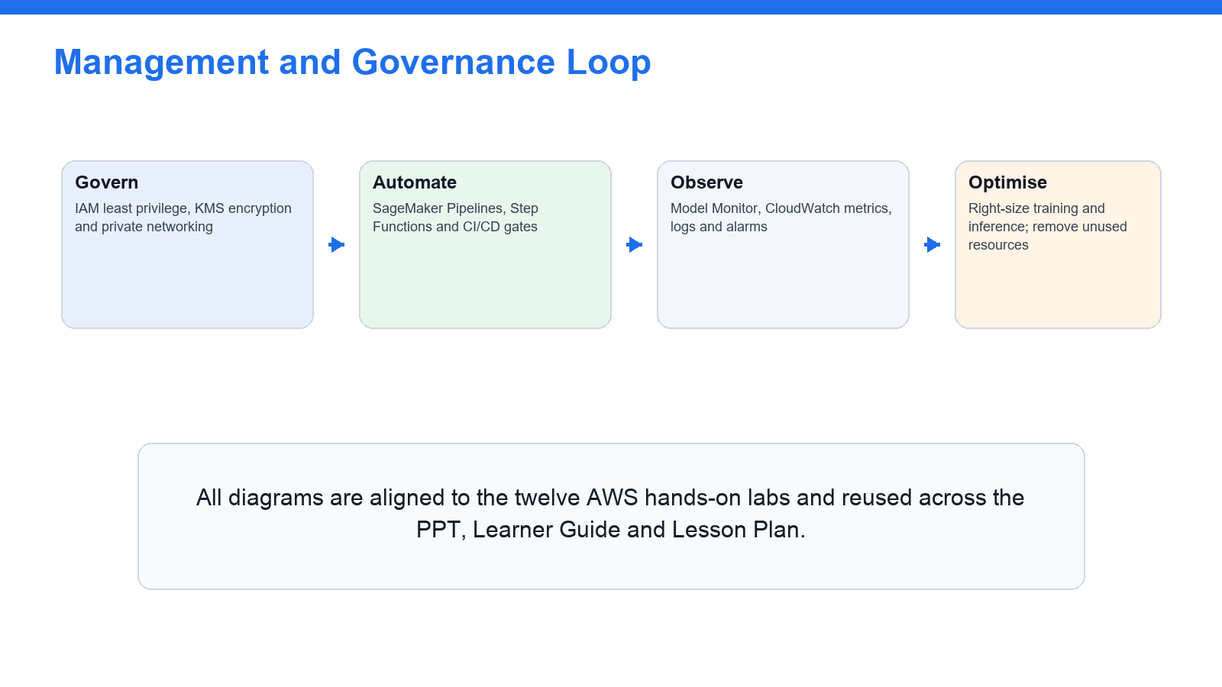
OPERATE SAFELY
Governance & Monitoring in Production
Govern, secure and audit ML workloads continuously in production.
AWS Certified Machine Learning Engineer Associate Training · TGS-2024049340
© 2026 Tertiary Infotech Academy Pte Ltd
148

Slide 150
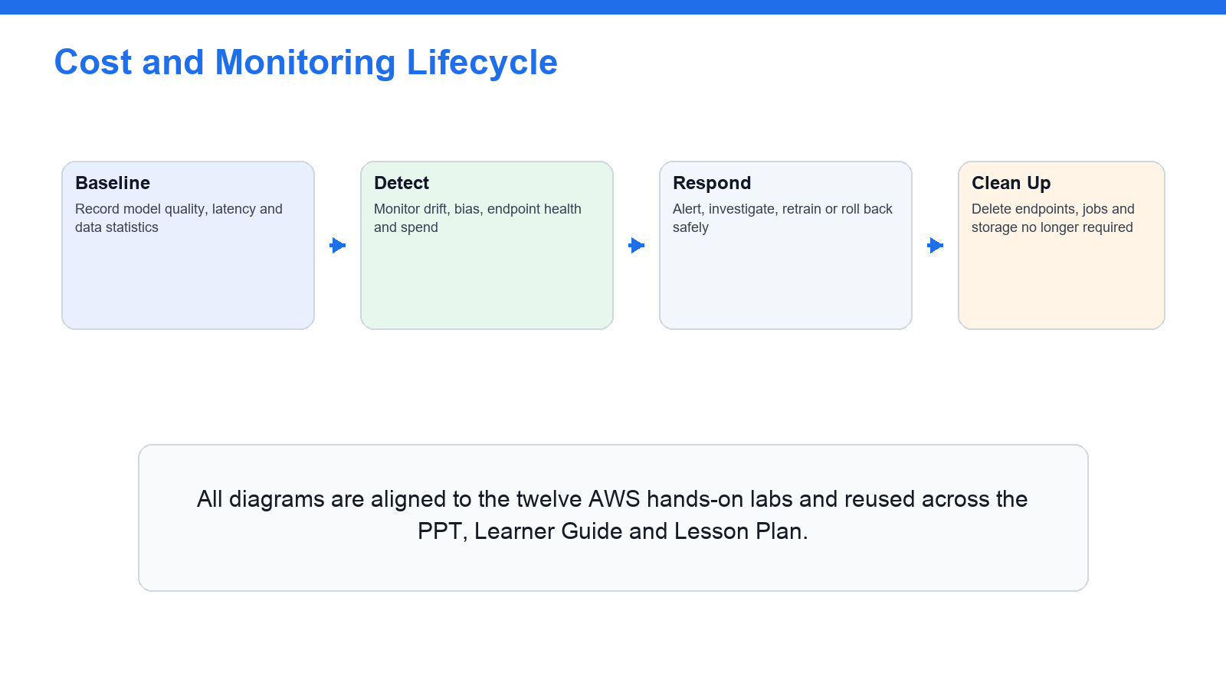
KEEP ML HEALTHY & EFFICIENT
Monitoring & Cost Optimisation Loop
Monitor drift and spend, then right-size and retrain — a continuous loop.
AWS Certified Machine Learning Engineer Associate Training · TGS-2024049340
© 2026 Tertiary Infotech Academy Pte Ltd
149

Slide 151
NEXT STEPS
Preparing for the MLA-C01 Exam
• Redo every lab until the AWS console and CLI workflow is automatic.
• Review the Key Concepts and the 'Test it' check for each lab and domain.
• Practise mapping each scenario to the right AWS service and the four exam domains.
• Take the AWS official MLA-C01 practice question set and the Tertiary practice exam.
• Book the exam via Pearson VUE or PSI (online proctoring or a test centre).
AWS Certified Machine Learning Engineer Associate Training · TGS-2024049340
© 2026 Tertiary Infotech Academy Pte Ltd
150

Slide 152
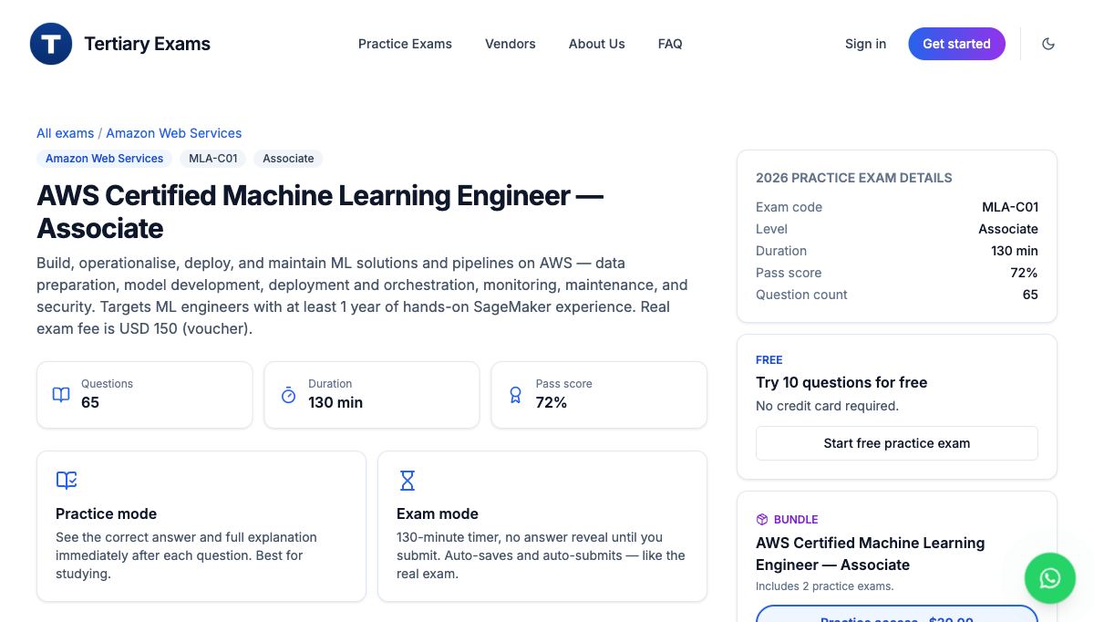
TEST YOURSELF · EXAMS PORTAL
Practice Exam
1
Open the Tertiary Infotech MLA-C01 practice exam.
https://exams.tertiaryinfotech.com/practice-exams/aws/aws-mla-c01
2
Attempt it under timed exam conditions.
3
Review the explanation for every question.
4
Revisit any lab whose domain you miss.
5
Re-take until you consistently pass.
AWS Certified Machine Learning Engineer Associate Training · TGS-2024049340
© 2026 Tertiary Infotech Academy Pte Ltd
151

Slide 153
WRAP-UP
Assessment
• Written Assessment (SAQ) — 1 hour. Case Study (CS) — 1 hour.
• Open book: slides, Learner Guide and approved materials only.
• Remember to take the Assessment digital attendance (TRAQOM).
• Submit your completed answers on the LMS at https://lms-tms.tertiaryinfotech.com/.
AWS Certified Machine Learning Engineer Associate Training · TGS-2024049340
© 2026 Tertiary Infotech Academy Pte Ltd
152

Slide 154
ON ASSESSMENT DAY
Assessment Flow
1
2
3
4
5
▶
▶
▶
▶
TRAQOM survey — scan the QR code on the LMS
Assessment digital attendance — scan the SSG QR
Sit WA (SAQ) then Case Study (CS) — open book
Submit your answers on the LMS
Sign the Assessment Summary Record
AWS Certified Machine Learning Engineer Associate Training · TGS-2024049340
© 2026 Tertiary Infotech Academy Pte Ltd
153

Slide 155
TRAQOM · SSG DIGITAL ATTENDANCE (PM)
Digital Attendance (Mandatory)
Mandatory each session
Take AM, PM and Assessment digital attendance for WSQ-funded courses.
TRAQOM QR code
The trainer displays the SSG digital-attendance QR code (TRAQOM).
1
2
Scan to submit
Scan the QR code with your mobile phone camera and submit your attendance.
75% minimum
At least 75% attendance is required to be eligible for assessment and funding.
3
4
AWS Certified Machine Learning Engineer Associate Training · TGS-2024049340
© 2026 Tertiary Infotech Academy Pte Ltd
154

Slide 156
GOOD LUCK WITH MLA-C01
Thank You!
You are now ready to build ML solutions on AWS — and to sit the AWS Certified Machine Learning Engineer - Associate (MLA-C01) exam.
AWS Certified Machine Learning Engineer Associate Training · TGS-2024049340
© 2026 Tertiary Infotech Academy Pte Ltd
155

